Slide 2
Advanced workload scheduling for containers on AWS
CON419
Nathan Peck
Sr Developer Advocate
Amazon Web Services

Slide 3
What is container scheduling?

Slide 4
In the old days applications were very static
Application runs on a server that sits in a closet somewhere running 24x7
The application runs for weeks, months, or even years without updates

Slide 5
The cloud is much more dynamic!
Applications run across many instances, of different sizes.
Applications scale up and down throughout the day. Don’t pay for capacity that isn’t needed
x 10
x 20

Slide 6
Developers don’t want to hand manage applications
Application A
Where is the application running?
How many copies are running?
Did one of the application processes crash without me noticing? Time to update the code… do I really have to SSH to all these hosts?
Application A
Application B
Application B
Application A

Slide 7
A scheduler does that work automatically
Application A
Application A
I want to run these two applications on these servers
Application A
Application B
Application B
Okay I can do that for you!
Application B
Application A

Slide 8
A scheduler does that work automatically
Application A
Application A
Update my application B to a new version of the code
Application A
Application B ²
Application B ²
Okay I can do that for you!
Application B ²
Application A

Slide 9
Advanced scheduler strategies

Slide 10
One scheduler, many strategies
Densely pack applications onto available instances to save money.
This helps you to be able to scale down the number of instances to save money.
Application A
Application B
Application C
Application D

Slide 11
One scheduler, many strategies
Availability Zone 1
EC2 instance
Application A
Ensure that applications are evenly distributed across availability zones.
If any single availability zone is lost there will still be instances of the application running
Application B
Availability Zone 2
EC2 instance
Application A
Application B

Slide 12
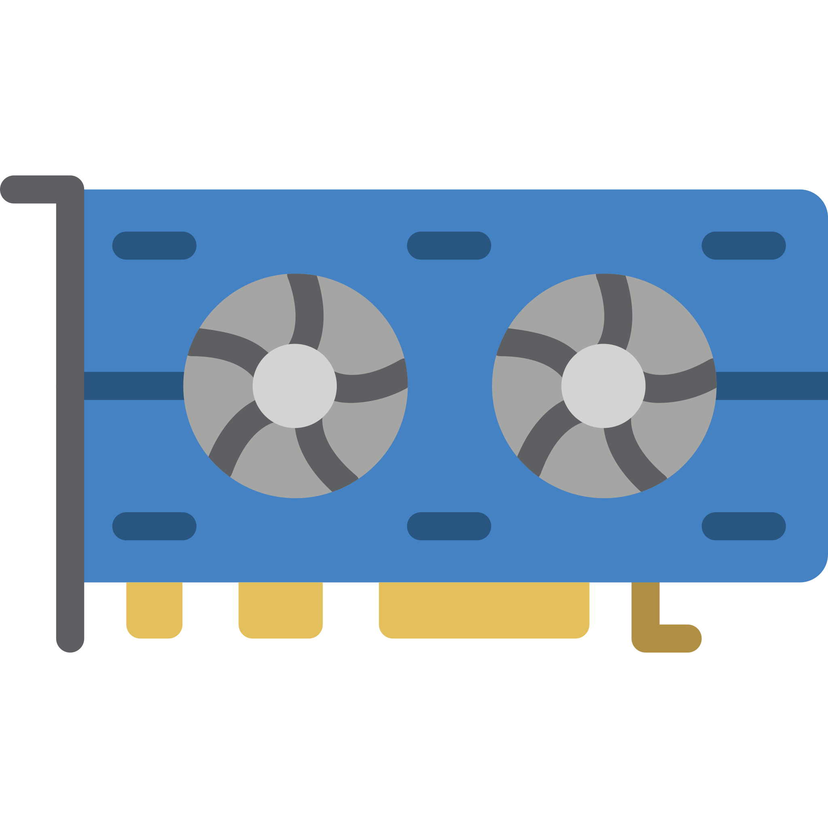
Schedule across multiple dimensions
Application A
“I need half of a CPU core and a max of 512 MB of memory”
CPU
RAM
Application B
”I need 2 CPU cores, at least 4 GB of memory (but don’t limit me if I need more) and I also need a GPU
GPU

Slide 13
You can provide a mixed pool of instances
4 x vCPU
Application A
No GPU’s
8 GiB RAM
c5.xlarge
64 x vCPU
4 x GPU
Application B
488 GiB RAM
g3.8xlarge

Slide 14
Scheduling based on container dependencies
Real world work often turns into a tree of steps that depend on each other, some steps can happen in parallel, while others must wait for the previous one to finish
Download data
Clean data
Train model using GPU
Crunch numbers using CPU
Upload results to S3

Slide 15
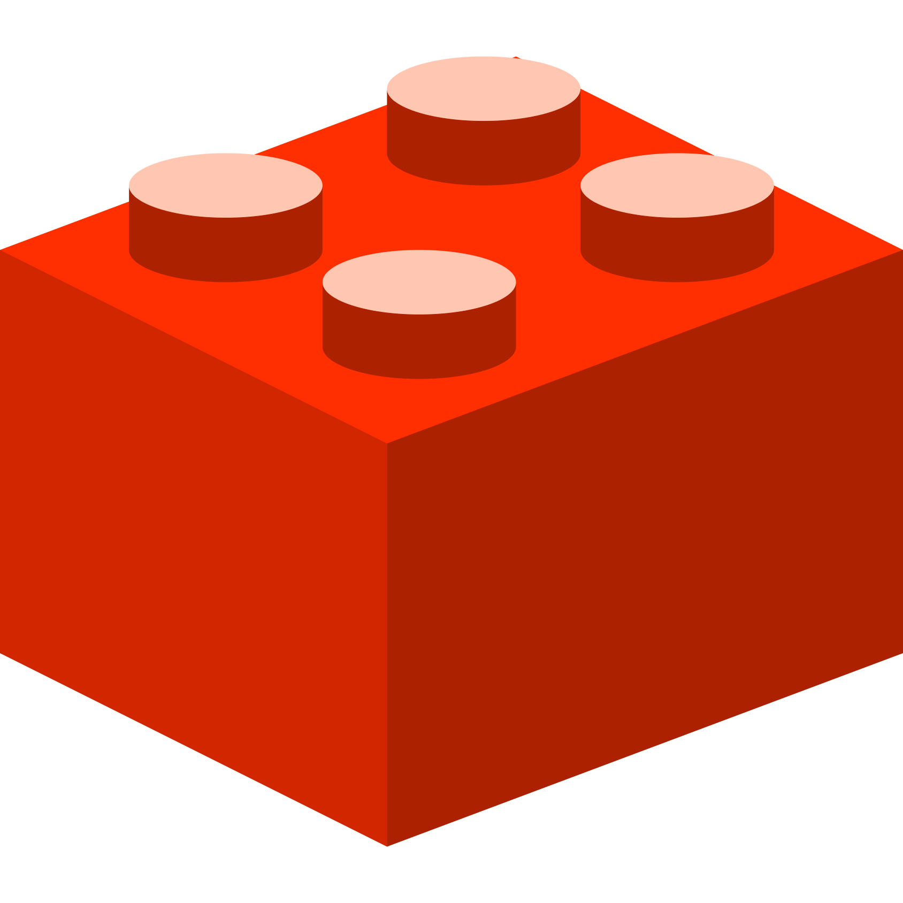
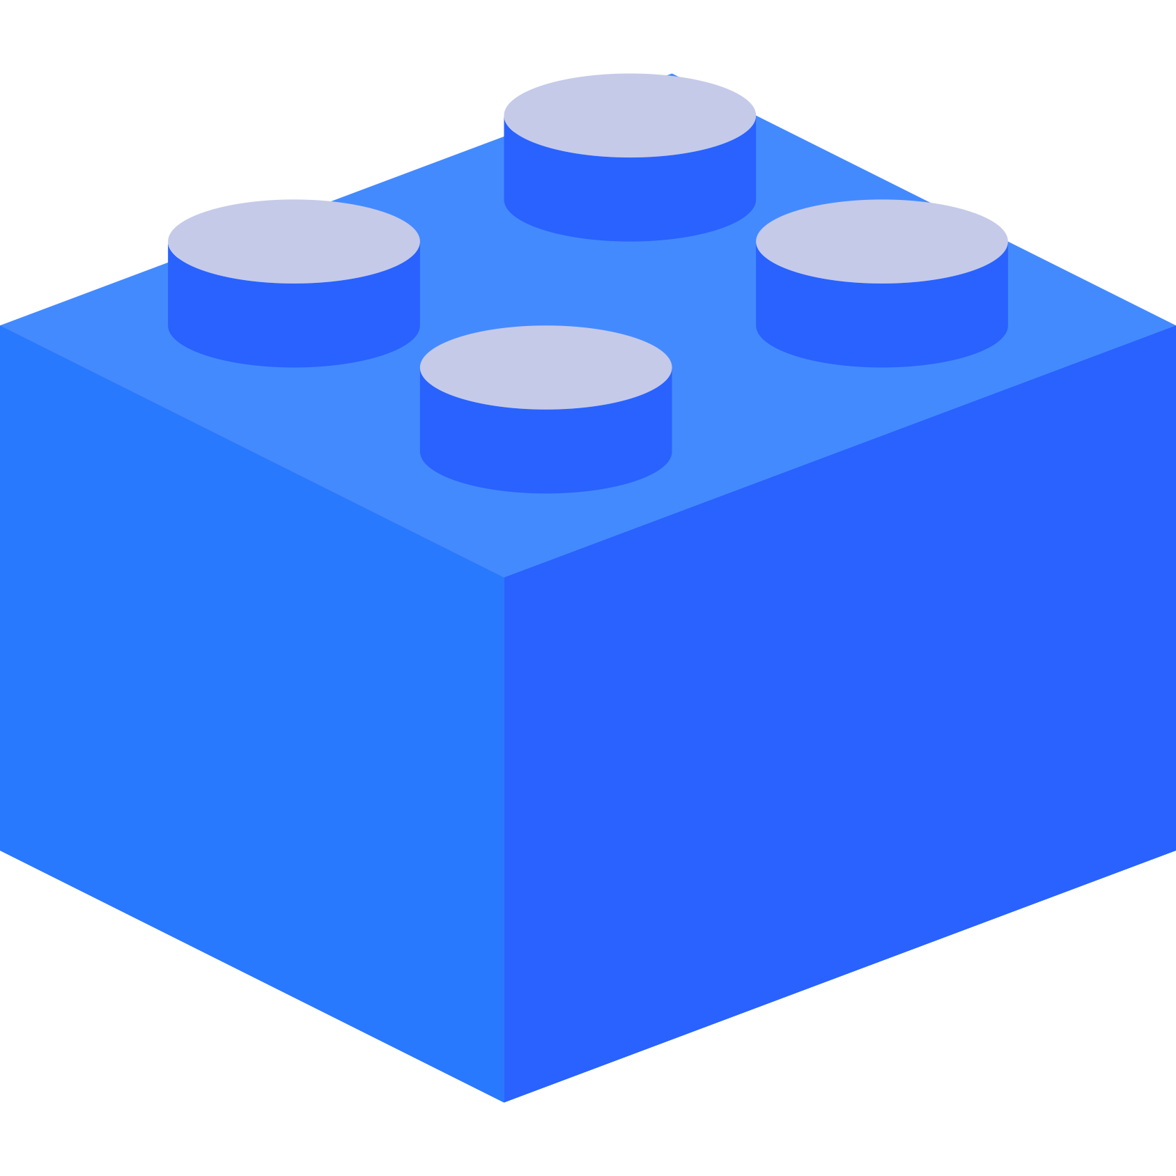
ECS supports container dependencies
Each of these steps can be scheduled as its own container with its own resource dimensions
2 x vCPU
4 GiB RAM
4 x vCPU
Download data
32 GiB RAM
Clean data
2 GPU
Train model using GPU
2 x vCPU
.5 vCPU
Crunch numbers using CPU
4 GiB RAM
4 GiB RAM
Upload results to S3

Slide 16
Demo (Let’s build it!)

Slide 17
Nathan Peck
Twitter: @nathankpeck
Email: peckn@amazon.com

