Slide 1
SRV 205
Architectures and Strategies for Building Modern Applications on AWS
Nathan Peck
Developer Advocate, Container Services
@nathankpeck

Slide 2
“…application is container-based”
Key Primitives
of a
Modern
“…dynamically managed…”
Application?
…microservice oriented…”
Notes:
First, we should level-set on the definition of “modern”. What is a modern application?
For me, the definition I build from is what CNCF has stated around cloud-native applications.
First, the application is Containerized. Each part (applications, processes, etc) is packaged in its own container. This facilitates reproducibility, transparency, and resource isolation.
Second, the application, service or system is dynamically orchestrated. Application containers are actively scheduled and managed to optimize resource utilization.
And third, the application is built in manner that is microservices-oriented. Components are segmented into microservices. This significantly increases the overall agility and maintainability of applications.
Principals
Architectural practices
Technologies
Services

Slide 3
“…application is container-based”
Key Primitives
of a
Modern
“…dynamically managed…”
Cloud Native
Application?
Application?
…microservice oriented…”
Notes:
So effectively, a “modern” application is an application that is built in a cloud-native manner.
But what if my application is not currently running in the cloud? That’s ok. These fundamental building principles still apply. Why?

Slide 4
Why Building Cloud Native Matters
Speed
Scale
Resiliency
Notes:
Building cloud-native applications brings with it three key benefits. For me those are:
Speed, time to value, and maximizing the pace of which a team can innovate.
Scale, or the ability to dynamically shift how an application runs in response to customer demand, and in a cost-oriented manner.
And of course resiliency, or the ability to deploy and operate your application in a manner that decouples failures and minimizes blast radius.

Slide 5
Key Building Blocks for Success
Containers + Functions
Cloud
Culture
Notes:
Let’s talk about 3 keys to that can accelerate your journey toward building modern, cloud-native applications.
Containers, Cloud, and Culture.

Slide 6
Key Building Blocks for Success
Containers + Functions
Cloud
Culture
Notes:
The first is Code packaging – Containers and functions, you need a way to package code so that it can be run anywhere, without needing to extensively configure the environment.

Slide 7
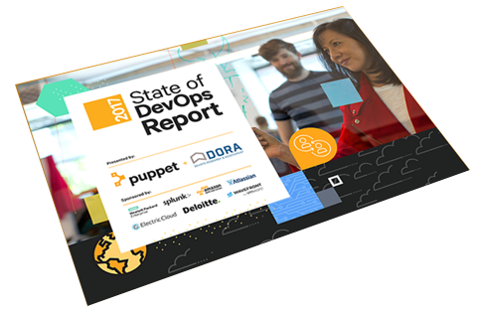
Key Building Blocks for Success
Time to Value
The fast
companies are
440x
faster than
the slow
We found that, compared to low
performers, high performers have:
46x more frequent code deployments
440x faster lead time from commit to deploy
96x faster mean time to recover from downtime
5.0x lower change failure rate (changes are 1/5 as likely to fail)
Containers + Functions
Cloud
Culture
https://puppet.com/resources/whitepaper/state-of-devops-report
Notes:
At the end of the day the important factor in our businesses is how quickly we can deliver value to our customers.
The 2017 Puppet State of DevOps report, which I would highly recommend everyone read, highlighted the growing gap between high performing and low performing companies. High performing, or fast, companies are organizations that can:
Deploy code more frequently;
Have a faster lead time from commit to deploy;
Have a faster Meant Time to Recover from downtime; and
A lower change failure rate than other companies.

Slide 8
Ship features,
not just code
Notes:
Containers are an enabling technology that allow developers to focus on their applications and, with the proper tooling, provide a mechanism for:
Testing and iterating on changes more quickly;
Deploying changes, features, to production in an immutable and controlled manner;
And again with proper tooling and infrastructure in place, offer an easy rollback to a prior version.

Slide 9
Containers Enable Fast Deployments
Deploy frequency (# of deploys per year)
1,600
1,200
800
400
0
2014
2015
2016
2017
High performers
Low performers
https://puppet.com/resources/whitepaper/state-of-devops-report
Notes:
Companies that are starting to adopt Containers as a core part of their infrastructure are able to deploy features and releases much faster.

Slide 10
Containers Enable Immutable
Changes/Rollback
Mean time to recover (hours)
Change failure rate (percentage)
100
60
80
50
60
40
30
40
20
20
10
0
0
2014
2015
2016
2017
2014
2015
2016
2017
High performers
Low performers
https://puppet.com/resources/whitepaper/state-of-devops-report
Notes:
And statistics show that they are able to recover in the event of an issue much more quickly; while also reducing the number of change related failures from “low” performing organizations.

Slide 11
Cloud Native Principle #1
Cloud Native Applications enable high functioning organizations to build and
ship features faster!
Notes:
This leads to our first “take away” point or principle:
Cloud Native applications, built using containers, enable high functioning organizations to build and ship features faster.

Slide 12
Key Building Blocks for Success
Containers + Functions
Cloud
Culture
Notes:
What role does the cloud play in this acceleration toward modern applications?

Slide 13
Cloud Native Architecture
Pay as you go
Self-Service
Elastic
Containers + Functions
Culture
Cloud
Notes:
The cloud allows us to focus not just on modern applications, but modern architectures. Let’s look at three principles, accelerators, or value points.
Pay as you go
Self service, API driven
Elasticity and Scalability

Slide 14
Data Center Native
Architecture
DATA CENTER
Notes:
Data Center Native architectures involve us purchasing racks of servers and moving these into physical buildings. Those buildings eventually have limits of space, power, cooling, etc.

Slide 15
Data Center Native
Infrastructure
Architecture
Lives for years
DATA CENTER
Notes:
Data Center Native architectures also tend to stay around for a long time; they have too – we spent a lot of money to build those buildings and to buy those servers.

Slide 16

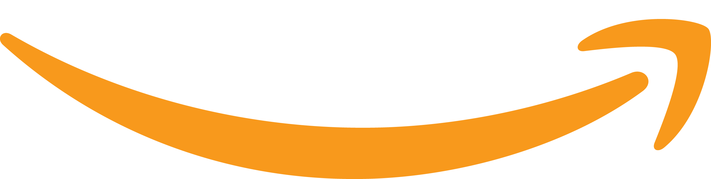
Cloud Migration
Pay as you go
Pay up front and depreciate over three years
Pay a month later for the number of seconds used
Applications and data
DATACENTER
Notes:
However, a Cloud Native architecture allows us the flexibility and adaptability to only pay for the infrastructure that we consume, by the second in most cases, which also allows us to dynamically make business decisions in what applications, projects, and technologies we build upon and invest in.

Slide 17
Cloud Native Principle #2
Pay for what you used last month, not what you guess you will need next year.
Enable teams to experiment and fail fast, without significant investment.
Notes:
Take home point #2: with a cloud native architecture you only pay for what you consume and to dynamicaly decide on where to make strategic investments across your business.

Slide 18




File tickets and wait for every step
Self service,
on-demand, no delays
!
!
VS
Notes:
With the a cloud native architecture you also change from a model of filing a ticket and waiting for a response (days) to a self-service, on-demand model that is API driven (seconds, minutes).

Slide 19
File tickets and wait for every step
Self service,
on-demand, no delays
!
!
!
Deploy by filing a ticket and waiting days or weeks
Deploy by making an API call self service within minutes
VS

Slide 20
Cloud Native Principle #3
Self service, API driven, automated.
Move from request tickets at every step to self-service APIs and tools that empower teams.
Notes:
Building modern application architectures allow us to move to a self-service, API-driven, and fully automated model. This can encapsulate everything from new capacity requests, infrastructure provisioning, to application deployments.
We’ll cover this a bit more detail later in the talk.

Slide 21
Elasticity
DATA CENTER
CLOUD
Hard to get over 10% utilization— need extra capacity in case of peak.
Target over 40% utilization—
and scale on demand for any size workload.
Notes:
We also see that in most data center architectures it’s hard for organizations to get above 10% utilization. They need to reserve capacity for peak traffic. But with the cloud customers are able to target over 40% utilization, with the ability to scale on demand for nearly any size workload.
This again gives developers freedom to experiment, move quickly, while also being cost-conscious.

Slide 22
Cloud Native Principle #4
Turn it off when it’s idle.
Scale for workloads of any size.
Many times higher utilization.
Huge cost savings.
Notes:
Our fourth take home point, when building with cloud native architectures you can turn it off when idle (scale down), while also having the ability to turn up new infrastructure for experimentation, or in response to customer traffic.

Slide 23
Resiliency
Blast
Radius
Loosely
Coupled
Geographically Distributed
Notes:
Another value point that building cloud-native, modern applications offer is the concept of loosely coupled dependencies and services, also called as microservices.
A microservice architecture is a method of developing applications as a suite of independently deployable, small, modular services, generally running in containers, and can be part of a larger service or system.

Slide 24
Microservices limit “blast radius” for software incidents
Build and deploy loosely coupled services.
Enable teams to move fast independently.
Reduce blast radius via service and deployment isolation.
Notes:
With a microservices architecture:
You can limit “blast radius” for software-related incidents.
Enable organizations to work on components, deploy, scale, and make changes independently.
Distribute applications and run highly available architectures with availability zones and single regions.

Slide 25
Notes:
As you grow you can continue to run these architectures in a globally distributed manner.
With AWS as a cloud provider you have access to over 18 regions and 53availability zones.

Slide 26
Cloud Native Principle #5
Microservices reduce blast radius, can improve MTTR, and support globally distributed deployment models.
Notes:
Fifth take home point: MTTR = Mean Time To Repair
Building microservices is a critical to enabling developers to move more quickly with decoupled components that can be worked on and deployed independently, and scaled and distributed independently in response to the needs of your business.

Slide 27
Key Building Blocks for Success
Containers + Functions
Cloud
Culture
Notes:
The tech parts here are great, and perhaps well understood. As we work with customers, we find that there is another significant component to accelerating transitions to modern applications, and that is the organizations culture.

Slide 28
Key Building Blocks for Success
“You don’t add innovation to a culture, you get out of its way.”
—Adrian Cockcroft, VP Cloud Architecture Strategy, AWS
Containers + Functions
Cloud
Culture
Notes:
This quote from Adrian Cockcroft is always a great place to start when talking about organizational culture, in my opinion.
Let’s highlight 3 ideas that can help us build a culture that supports innovation.

Slide 29
Organization Transformation
“…teams build software that patterns
their organizational structure…”
—Conway’s Law
Notes:
The first is Conway’s law. That tells us that teams build software that patterns their organizational structures.
So, small, agile teams, with direct component-level ownership may be the best way to organize your teams if you want to build, deploy, and operate microservice patterned applications. Get direct alignment between your teams and the software they own.

Slide 30
“You build it, you run it.”
—Werner Vogels, VP & CTO Amazon.com
Notes:
The second organizational culture idea is that the engineers building the software should also run it.
It turns out that nobody really likes being woken up in the middle of the night due to operational issues, and in my experience when the people building the software also operate it, generally this leads to a higher operational bar. This includes the managers. They should be in the escalation rotation for the services they own.
I’m still in all the escalations for the services that my team owns and I find it keeps me grounded and connected to the details of our product and the experience we’re providing our customers.

Slide 31
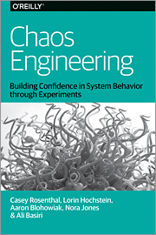
“Not what happens IF it fails,
but what happens WHEN it fails.”
—Nora Jones, Author, and Sr. Chaos Engineer at Netflix
Notes:
The last idea here is that planning for failures is just as important as trying to prevent it. The ideas around chaos engineering and the work that that Netflix team has talked about over time with their chaos engineering approach really helps to build a preventative, proactive culture within the team – and a team that is well-prepared for a crisis if / when it should occur.

Slide 32
Principals of Modern, Cloud Native Apps
Containers + Functions
Cloud
Culture
Notes:
Recap slide

Slide 33
Technology Choices
Functions
Containers
Monitoring
Messaging
Notes:
When you’re building a modern app, there’s multiple technologies that you need to use.
These include functions, containers, monitoring, and messaging

Slide 34
So What Does A Modern App Look Like?
How you run and interact with it
How it integrates
How you monitor it
Notes:
So let’s see these principals applied in action
How you run and interact with it
ECS
Lambda (Functions)
Fargate
How it integrates
Messaging (Amazon SQS, Amazon SNS)
Orchestration (AWS Step Functions)
How you monitor it
Monitoring
Tracing

Slide 35
AWS Lambda
Bring your own code
Node.js, Java, Python,
C#, Go
Bring your own libraries (even native ones)
Simple resource model
Select power rating
from 128 MB to 3 GB
CPU and network allocated proportionately
Flexible use
Synchronous or asynchronous
Integrated with other AWS services
Flexible authorization
Securely grant access to resources and VPCs
Fine-grained control for invoking your functions
Notes:
AWS Lambda provides event-driven serverless functions. Lambda lets you upload code, set triggers, and when those triggers are met it runs the code. Lambda is great for building services that must respond to data events in real-time.
You have a simple resource model that lets you determine exactly how much memory your code needs to run and CPI and networking resources are allocated proportionally.
Lambda is pre-built to access, alter, and react to data from 18 (and growing) different event sources including S3, Kinesis, and DynamoDB. Data collected into an S3 data lake can invoke Lambda functions to process events, from image resizing to machine learning inference. Lambda functions can automatically read and process Kinesis streams that continuously capture and store terabytes of data per hour from hundreds of thousands of sources such as website clickstreams, financial transactions, social media feeds, and IT logs.
Lambda has deep security integrations with fine grained controls for accessing other resources and function invocation.

Slide 36

AWS Lambda
Authoring functions
WYSIWYG editor or upload packaged .zip
Third-party plugins (Eclipse, Visual Studio)
Monitoring and logging
Metrics for requests,
errors, and throttles
Built-in logs to Amazon CloudWatch Logs
Programming model
Use processes, threads, /tmp, sockets normally
AWS SDK built in
(Python and Node.js)
Stateless
Persist data using external storage
No affinity or access to underlying infrastructure
Notes:
With AWS Lambda, you only need to manage application code, as both the data source integrations and infrastructure components are fully managed by AWS.
You use a WYSIWYG editor or third party plugins to author and push your functions. Monitoring and loggin integrations are included including AWS X-ray for distributed applictation tracing.

Slide 37

“Using AWS Lambda, we’ve increased cost efficiency
by a factor of two”
—Tim Griesbach, Senior Director of Technology, FINRA
FINRA performs
500 Billion validations daily
using AWS Lambda
Notes:
FINRA is the Financial Industry Regulatory Authority— has created a flexible platform that can adapt to changing market dynamics while providing its analysts with the tools to interactively query multi-petabyte data sets.
FINRA is dedicated to investor protection and market integrity. It regulates one critical part of the securities industry – brokerage firms doing business with the public in the United States. To respond to rapidly changing market dynamics, FINRA moved about 90 percent of its data volumes to Amazon Web Services, using AWS to capture, analyze, and store a daily influx of 37 billion records.

Slide 38
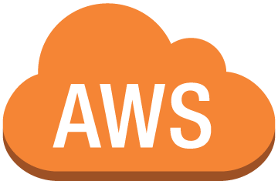
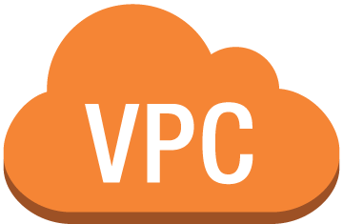


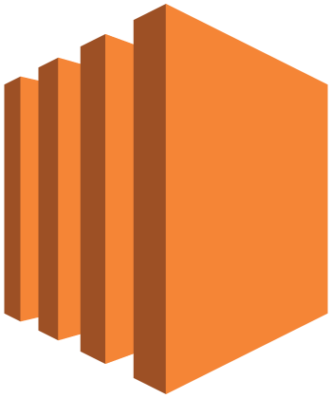
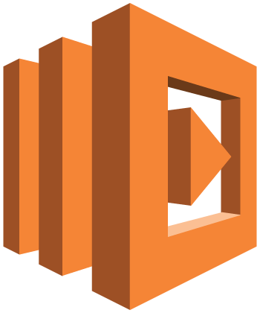





Lambda preforms record validations
Amazon SQS
Amazon
RDS
Controller on EC2
Controller manages Lambda process
Amazon
SQS
Amazon
SQS
…
Logs to CloudWatch Logs
Consumers
Amazon
S3
Copy files to S3
Incoming files to be audited
NAS
FTP
On-premises data center
Notes:
FINRA’s Order Audit Trail System (OATS) is part of an integrated audit trail of order, quote, and trade events for all National Market System (NMS) stocks and over-the-counter (OTC) equity securities, and is used to monitor the trading practices of member firms. FINRA uses OATS data, along with other market data, to create the life cycle of each order.
As soon as data is received, FINRA validates it to ensure it is complete and correctly formatted according to a set of more than 200 rules. The system performs up to half a trillion validations each day.
FINRA developed the solution in only three months, including testing to ensure the system could handle peak loads. Data is ingested into Amazon Simple Storage Service (Amazon S3) via File Transfer Protocol (FTP). AWS Lambda functions perform the validations. FINRA repurposed part of the original validation architecture as a controller for AWS Lambda processes. The controller runs on Amazon EC2 and manages both data feeds coming into AWS Lambda and notifications going out of it.
The system relies heavily on messaging to coordinate services, using Amazon Simple Queue Service (Amazon SQS) for input/output notifications. In addition, FINRA uses Amazon Virtual Private Cloud (Amazon VPC) to partition the system into separate test and production accounts to protect the live-validation process from errors.

Slide 39

Amazon Elastic Container Service (ECS)
  Container-Level Networking
  Advanced task
  placement
  Deep integration
  with AWS platform
  ECS CLI
  Global footprint
  Powerful
  scheduling engines
  Auto scaling
  CloudWatch metrics
  Load balancers
…
{
}
Notes:
Fully managed control plane
Scalable and highly available
Container-level networking
Advanced task placement
Powerful scheduling engines
Global footprint
Deep integration with AWS Platform
Container metadata API
Healthchecks
Load balancers
Integrated service discovery
Hundreds of millions of containers launched per week
To ensure we can support every workload, we’ve provided containers running on Amazon ECS
deep integration with the breadth of AWS platform features and capabilities to make it easier to run container-based applications in production.
These integrations include support for AWS VPC task networking, IAM roles and Security Groups for tasks, Load Balancer support (ELB, ALB, NLB), Task Auto Scaling for clusters and Tasks, and CloudWatch Metrics and Logs.
We also provide a rich set of developer tools to make it easier to build complex applications on AWS, including integration with AWS CodePipeline and the ECS CLI which offers a simplified, yet powerful, user experience for getting started with ECS.
With ECS and Auto Scaling, customers can run applications that can grow to support cloud-scale applications.
^^^ Nate
What do you think about talk track here?
?? Can we ship logs from ECS to CloudWatch logs?

Slide 40

McDelivery
Notes:
So let’s see an example with managed compute, McDonalds.
Over $1b of revenue from digital channels in the Asia Pacific and Middle East regions
37k restaurants
1.9 million people employed
120 countries
64m+ customers served daily
They needed to build a single global platform servicing customers and restaurants with some of the world’s leading food delivery partners
Major APIs for functionality such as ordering
Ability to handle breakfast, lunch and dinner peak volumes

Slide 41
Critical Business Requirements
Speed to market
Scalability and reliability
Multi-country support and integration
Cost sensitivity
Notes:
Speed to market, quick turn around for features and functionality from concept to production
Scalability and reliability, targets of 250K–500K orders per hour
Multi-country support and integration with multiple third-party
food delivery partners
Cost sensitivity, cost model based on low average check amounts

Slide 42
Key Architecture Principles
Microservices
Containers and orchestration
PaaS
Synchronous and event based
Notes:
Microservices, with clean APIs, service models, isolation, independent data models and deployability.
Containers and orchestration, for handling massive scale, reliability and speed to market requirements
PaaS, based architecture model by leveraging AWS platform components such as ECS, SQS, RDS and Elasticache
Synchronous and event based, programming models based on requirements .

Slide 43
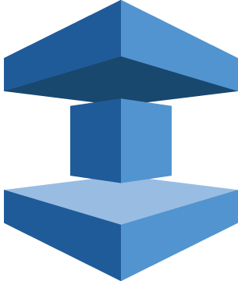

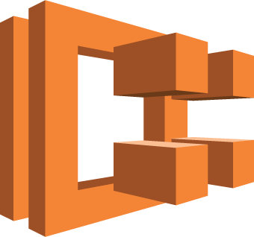
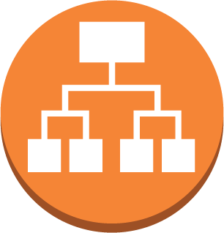
Menu and Restaurant
Master
Amazon
SQS
Amazon
RDS
ElastiCache
(Redis)
Amazon
S3
Restaurant
Microservice 1
Microservice 2
Auto Scaling Group
Multi-AZ
Auto Scaling Group
Multi-AZ
Third-party Delivery Platforms
Amazon ECS
Application Load Balancer
McD API Middleware
Notes:
Key Architecture Principles
Microservices, with clean APIs, service models, isolation, data models and deployability.
Containers and orchestration, for handling massive scale, reliability and speed to market requirements
PaaS, based architecture model by leveraging AWS platform components such as ECS, SQS, RDS and Elasticache
Synchronous and event based, programming models based on requirements

Slide 44
Built entire system in months, all on AWS
Out of the box integration and deployment models with ECS simplified DevOps pipeline
Open platform that integrates with any restaurant and global delivery partners
Over 20K transactions per second, sub
100 millisecond latency
Cost effective, even with extremely low transaction values
Notes:
Microservices, with clean APIs, service models, isolation, independent data models and deployability.
Containers and orchestration, for handling massive scale, reliability and speed to market requirements
PaaS, based architecture model by leveraging AWS platform components such as ECS, SQS, RDS and Elasticache
Synchronous and event based, programming models based on requirements .

Slide 45
Enable Focus on Applications
Notes:
Coming back to why building cloud-native applications matters, what these stories show, and what we’ve learned in the past three years from our deep involvement in the container, container orchestration, and microservices space is that at the end of the day developers, small businesses, startups, and enterprises alike, all just want to focus on their applications.

Slide 46
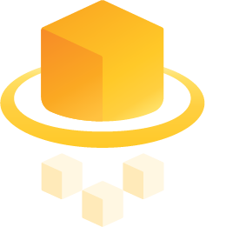
Introducing
AWS Fargate!
Notes:
We heard that feedback and as a result announced at the end of last year AWS Fargate, a new way to run containerized applications on AWS.
With AWS Fargate customers only need to think about their application and can get started by just specifying the container image name, CPU and memory that you want to provision to run the application. All the underlying infrastructure management is done for you as a part of the service. You can scale from running one container, to1000s, in just a matter of minutes.

Slide 47
Simple, easy to use, powerful consumption model
  No instances
  to manage
  Container
  native API
  Resource
  based pricing
Fargate
Notes:
We believe that Fargate enables developers to really take advantage of building and migrating to modern applications.
With Fargate:
There are no instances to manage; no more patching OS or runtimes to worry about.
A new container-focused Task Native API; no need to worry about clusters auto scaling or utilization.
Only pay for the resources you provision for each task.
We think Fargate fundamentally changes how you think about consumption; how you will run and deploy your applications with containers in the cloud.

Slide 48

Running a Container
Notes:
Getting started with container on a single node
To…

Slide 49

Running Containers
EC2 Instance
EC2 Instance
EC2 Instance
EC2 Instance
EC2 Instance
Task
Task
Task
Task
Task
Task
Task
Task
Task
Task
Task
Task
Task
Task
Task
Task
Task
Task
Task
Task
Notes:
Running many containers (or tasks) across many nodes.

Slide 50
EC2 Instance
ECSTask
ECSTask
ECSTask
ECSTask
ECS
agent
Docker
agent
ECS
AMI
Notes:
Under the hood on every node there is software that we also care about:
Docker versions
Agent versions
Daemon versions
All of which really have not direct impact on our actual application; but are required to run this infrastructure.

Slide 51
Running Containers at Scale with ECS
Scheduling and Orchestration
Amazon
Cluster Manager
Placement Engine
ECS
Availability Zone #1
Availability Zone #2
Availability Zone #3
Notes:
We begin to care a lot more about the management overhead of the individual nodes to make sure that we’re protecting the security boundaries, placing containers optimally for availability, and for cost purposes.
We run orchestration engines like Kubernetes or Amazon ECS to help us wit that.

Slide 52
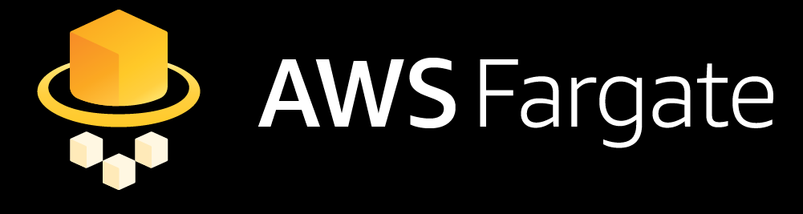
Scheduling and Orchestration
Amazon
Cluster Manager
Placement Engine
ECS
EC2 Instance
EC2 Instance
EC2 Instance
ECS
agent
Docker
agent
ECS
AMI
ECS
agent
Docker
agent
ECS
AMI
ECS
agent
Docker
agent
ECS
AMI
Notes:
With Amazon ECS and AWS Fargate you can now run these applications without needing to worry about any of the underlying infrastructure, enabling you, your teams, your organizations to focus entirely on what matters most to your business.

Slide 53

Get Started in Minutes
Notes:
Super simple to try this out today with our Getting Started experience in US-EAST-1 region.

Slide 54

Entire website runs as microservices. Ruby &
GraphQL backend with node.js frontend
Needed ability to scale quickly, schedule multi-container workloads, network layer control
All in on AWS—Moved entire infrastructure to AWS and Fargate in Jan 2018
Fargate scales quickly with traffic spikes, running
~25 tasks at baseline in production
Ship by Product Hunt
Marketing toolkit for makers to ship products | http://producthunt.com/ship/in/aws-summit
Notes:
All infrastructure has been on Heroku for the past 4 years.
Architecture has a lot of inter-service communications and despite lack of network layer control on Heroku, didn’t want to manage infrastructure. Limitations using EB for running and scheduling multi-container workloads.
Fargate solved this by abstracting infrastructure while giving the control over networking and how containers run.
Did a POC in December and by end of January 2018, all services are running on Fargate. This includes 4 clusters, 3 for staging and 1 for prod.
Website is Ruby on Rails and GraphQL backend with node.js frontend.
Found that Fargate scales well with traffic, running about 25 tasks at baseline in prod. Only running 1 EC2 instance to be able to run a single Rails app with Bash.

Slide 55

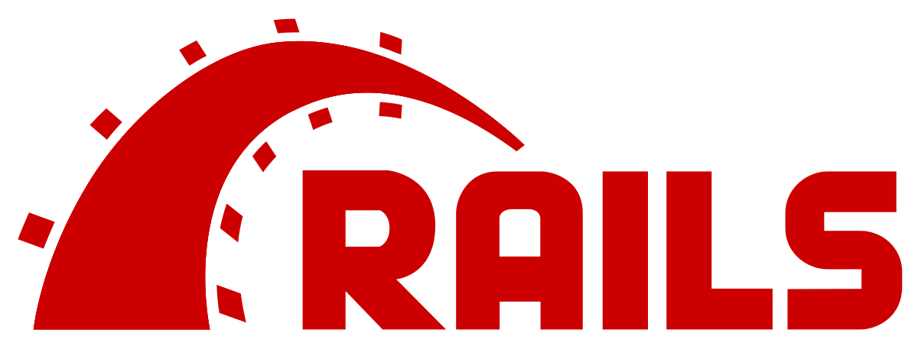
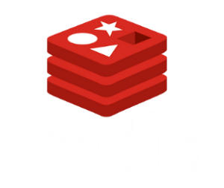
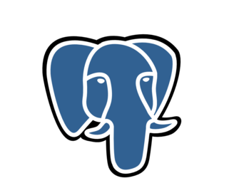
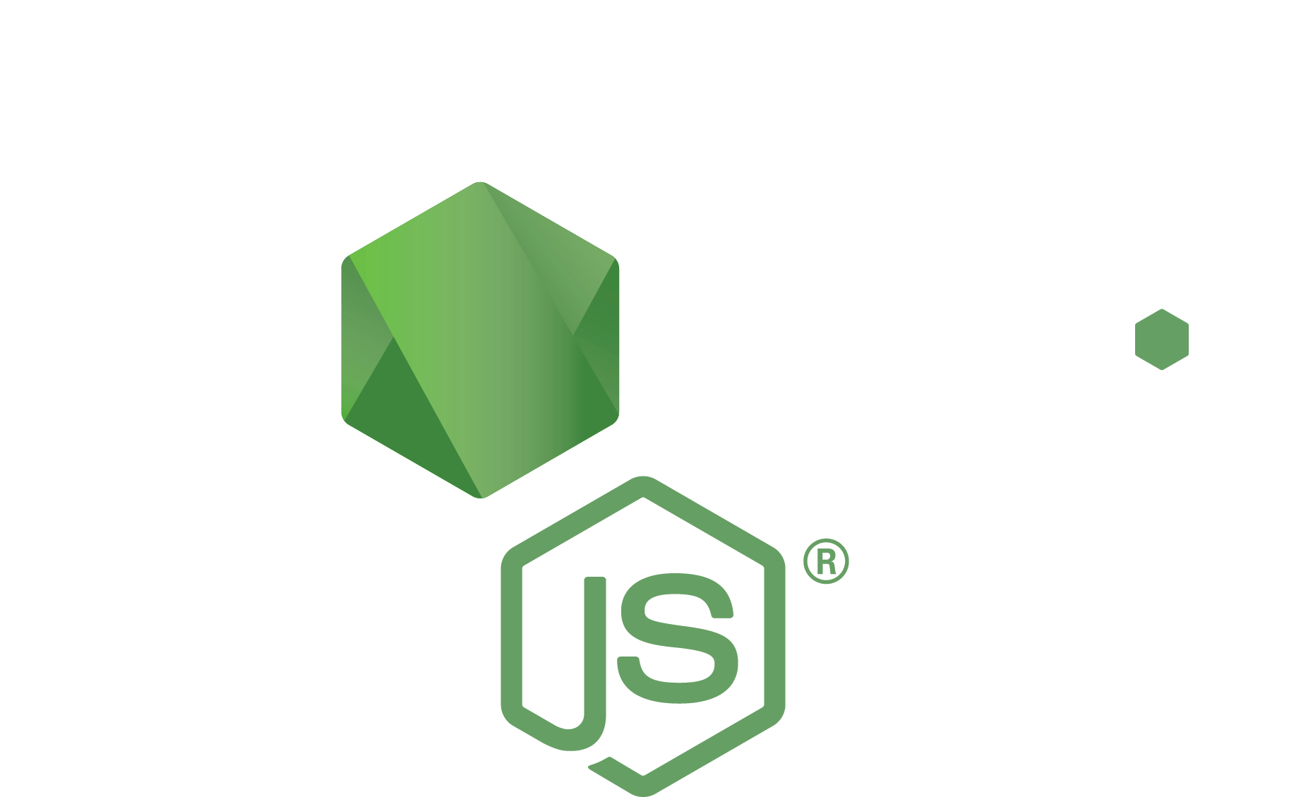

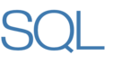
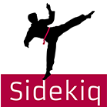
Public
Subnet
Private
Subnet
Backend Web External
API External
CDN
External
ALB
Internal
ALB
Background Web Internal
Frontend Web
External
Card/Scraper
Service
Background
Job Queues
Background
Workers
Notes:
All infrastructure has been on Heroku for the past 4 years.
Architecture has a lot of inter-service communications and despite lack of network layer control on Heroku, didn’t want to manage infrastructure. Limitations using EB for running and scheduling multi-container workloads.
Fargate solved this by abstracting infrastructure while giving the control over networking and how containers run.
Did a POC in December and by end of January 2018, all services are running on Fargate. This includes 4 clusters, 3 for staging and 1 for prod.
Website is Ruby on Rails and GraphQL backend with node.js frontend.
Found that Fargate scales well with traffic, running about 25 tasks at baseline in prod. Only running 1 EC2 instance to be able to run a single Rails app with Bash.

Slide 56
“We moved to Fargate because we need the ability to scale quickly up from baseline, run multi-container workloads, and get fine-grained network control, without having to manage our own infrastructure.”
Ship by Product Hunt
Marketing toolkit for makers to ship products | http://producthunt.com/ship/in/aws-summit
Notes:
All infrastructure has been on Heroku for the past 4 years.
Architecture has a lot of inter-service communications and despite lack of network layer control on Heroku, didn’t want to manage infrastructure. Limitations using EB for running and scheduling multi-container workloads.
Fargate solved this by abstracting infrastructure while giving the control over networking and how containers run.
Did a POC in December and by end of January 2018, all services are running on Fargate. This includes 4 clusters, 3 for staging and 1 for prod.
Website is Ruby on Rails and GraphQL backend with node.js frontend.
Found that Fargate scales well with traffic, running about 25 tasks at baseline in prod. Only running 1 EC2 instance to be able to run a single Rails app with Bash.

Slide 57

Application Integration: Messaging
Amazon SQS & SNS
Send, store, and receive messages between software components
Notes:
Messaging makes it easy to decouple and scale microservices, distributed systems, and serverless applications. Using Amazon Simple Queue Service (SQS), you can send, store, and receive messages between software components at any volume, without losing messages or requiring other services to be always available. Amazon SQS is deeply integrated with other AWS services to make easy to build more flexible and scalable applications. Integrations include compute services such as Amazon EC2, Amazon EC2 Container Service (Amazon ECS), and AWS Lambda, as well as with storage and database services. Amazon SQS works with SNS, sp you can use topics to decouple message publishers from subscribers, fan-out messages to multiple recipients at once, and eliminate polling in your applications. AWS services can publish messages to SNS topics to trigger event-driven computing and workflows.

Slide 58


Amazon Elastic Container Service for Kubernetes (EKS)
  Managed Kubernetes Control Plane
  Upstream and certified conformant
  Native AWS Integrations
  Built with the community
  Global footprint
  Highly available
  On-demand upgrades
  Generally available
  in 2018
Notes:
In addition to ECS, a lot of AWS customers run containers using Kubernetes. In fact, the majority of Kubernetes that runs on the cloud runs on AWS. Amazon EKS makes it easy to run Kubernetes on AWS by provisioning, updating, and scaling Kubernetes infrastructure for you EKS runs unmodified, upstream Kubernetes, which means applications running in your Kubernetes environment are fully compatible, so you can seamlessly move them to your EKS-managed cluster. Amazon EKS is built in partnership with the community to have deep integrations to the rest of the AWS platform including core AWS networking and security services., and on-demand upgrades handle moving your cluster to new Kubernetes versions when you decide to upgrade.

Slide 59

Amazon EKS
Kubectl
mycluster.eks.amazonaws.com
AZ 1
AZ 2
AZ 3
EKS Worker Nodes
Your AWS account
Notes:
With EKS, you simply provision your worker nodes and connect them to the EKS endpoint the AWS cloud. The workers live in your VPC and you have full control over your data at any time.

Slide 60
Amazon Elastic Container Service for Kubernetes (EKS)
  Managed Kubernetes Control Plane
  Upstream and certified conformant
  Native AWS Integrations
  Built with the community
  Global footprint
  Highly available
  On-demand upgrades
  Generally available
  in 2018
Notes:
Amazon EKS is currently in preview with general availability in 2018.

Slide 61
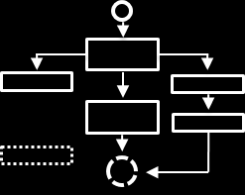
Application Integration: Orchestration
AWS Step Functions
Coordinate the components of distributed apps using visual workflows
Notes:
AWS Step Functions makes it easy to coordinate the components of distributed applications and microservices using visual workflows. Building applications from individual components that each perform a discrete function lets you scale and change applications quickly. Step Functions provides a graphical console to arrange and visualize the components of your application as a series of steps. This makes it simple to build and run multistep applications. Step Functions automatically triggers and tracks each step, and retries when there are errors, so your application executes in order and as expected. Step Functions logs the state of each step, so when things do go wrong, you can diagnose and debug problems quickly. You can change and add steps without even writing code, so you can easily evolve your application and innovate faster.

Slide 62
Monitoring: Amazon Cloudwatch
Monitor
Act
Analyze
Get metrics on
key resources
Observe
application and operational health
Monitor custom metrics and log files
SNS notifications
Automated alarm actions
Event-driven corrective actions
Visualize through Dashboards
1-sec granularity
Unified
operational view
15-months of
data retention

Slide 63
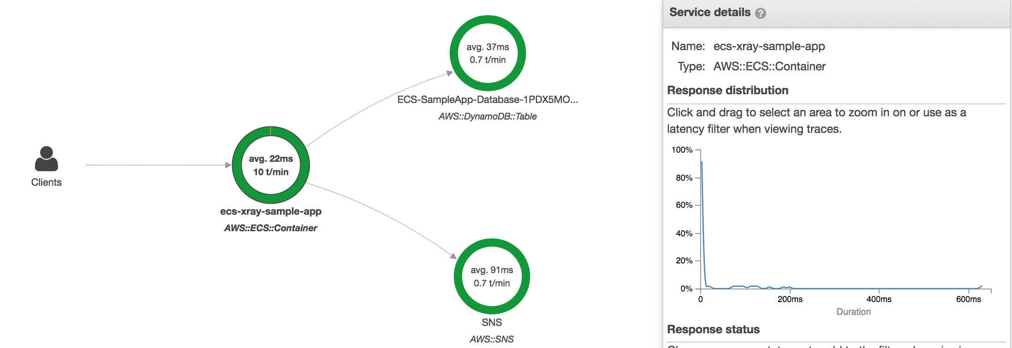
Distributed
Tracing
AWS X-Ray
Analyze and debug performance of distributed applications
View latency distribution and identify performance bottlenecks
Identify specific user impact across an application
Works across AWS and
non-AWS services
Ready to use in production with low latency in real-time
Notes:
Analyze and debug performance of your distributed applications.
View latency distribution and pinpoint performance bottlenecks.
Identify specific user impact across your applications.
Works across different AWS and non-AWS services.
Ready to use in production with low latency in real-time.
Enables you to get started quickly without having to manually instrument your application code to log metadata about requests

Slide 64
Key Building Blocks for Success
Containers + Functions
Cloud
Culture
Notes:
Let’s talk about 3 keys to that can accelerate your journey toward building modern, cloud-native applications.
Containers, Cloud, and Culture. So, in summary, the a few key building blocks we discussed that can accelerate your transition to modern applications are:
Containers
Cloud
Culture
And I’m excited to see what you all build next!

Slide 65
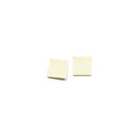





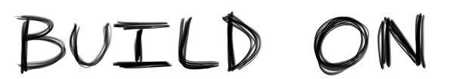

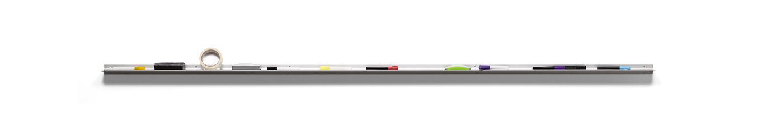
Notes:
Thank you!

Slide 66
Thank you!

Slide 67
Please complete the session survey in the summit mobile app.

Slide 68

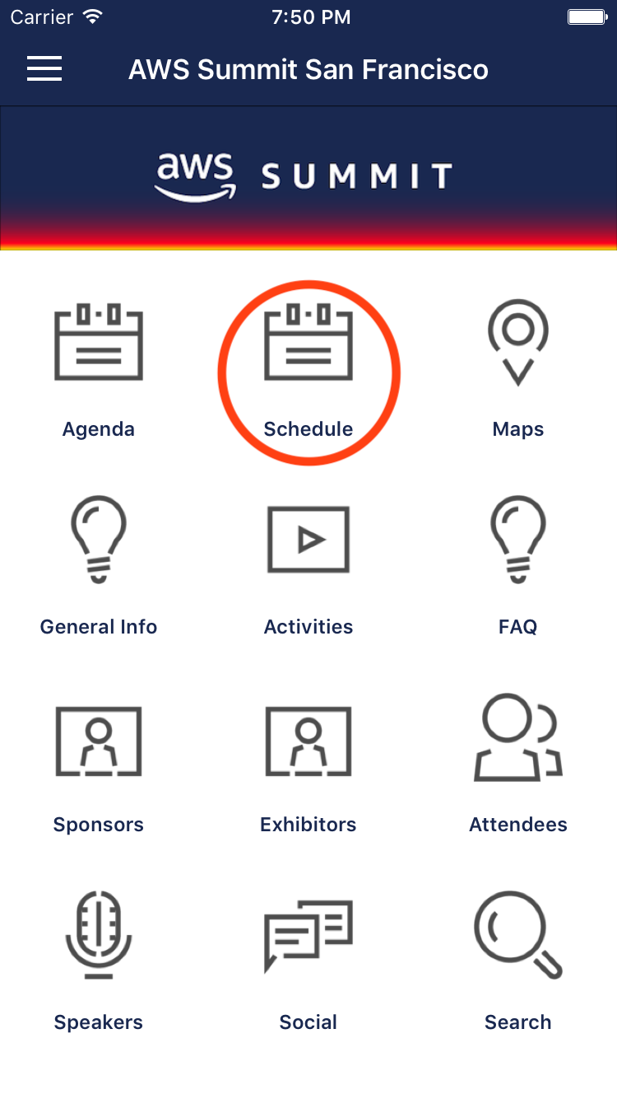
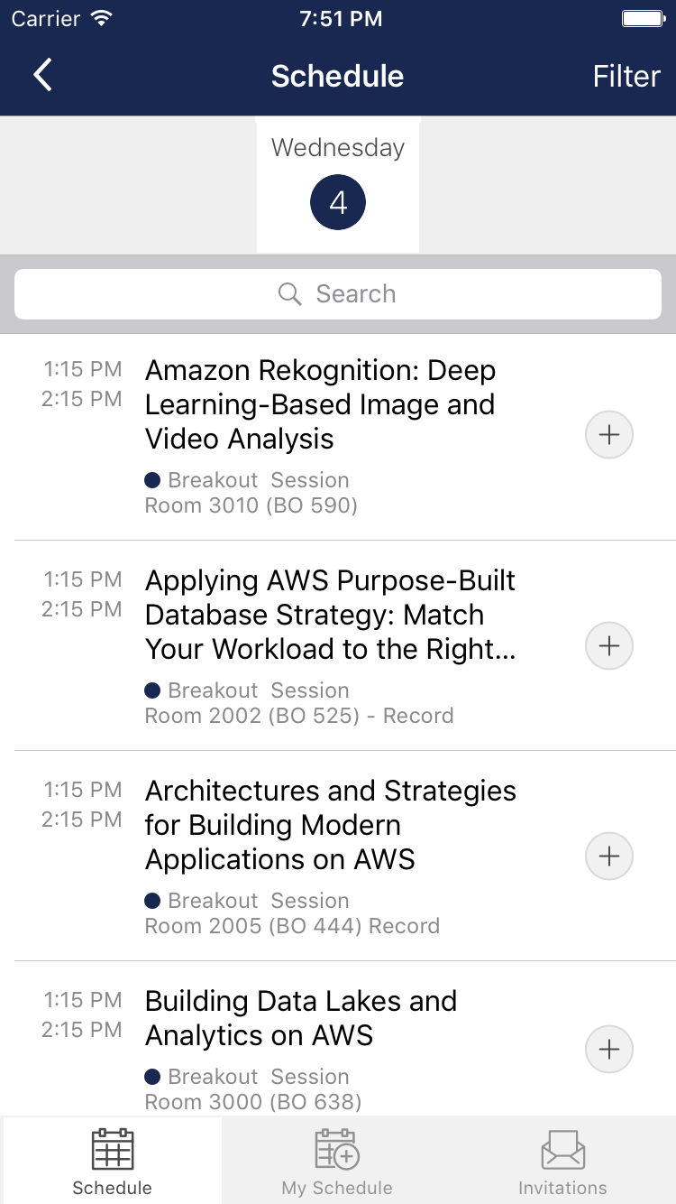
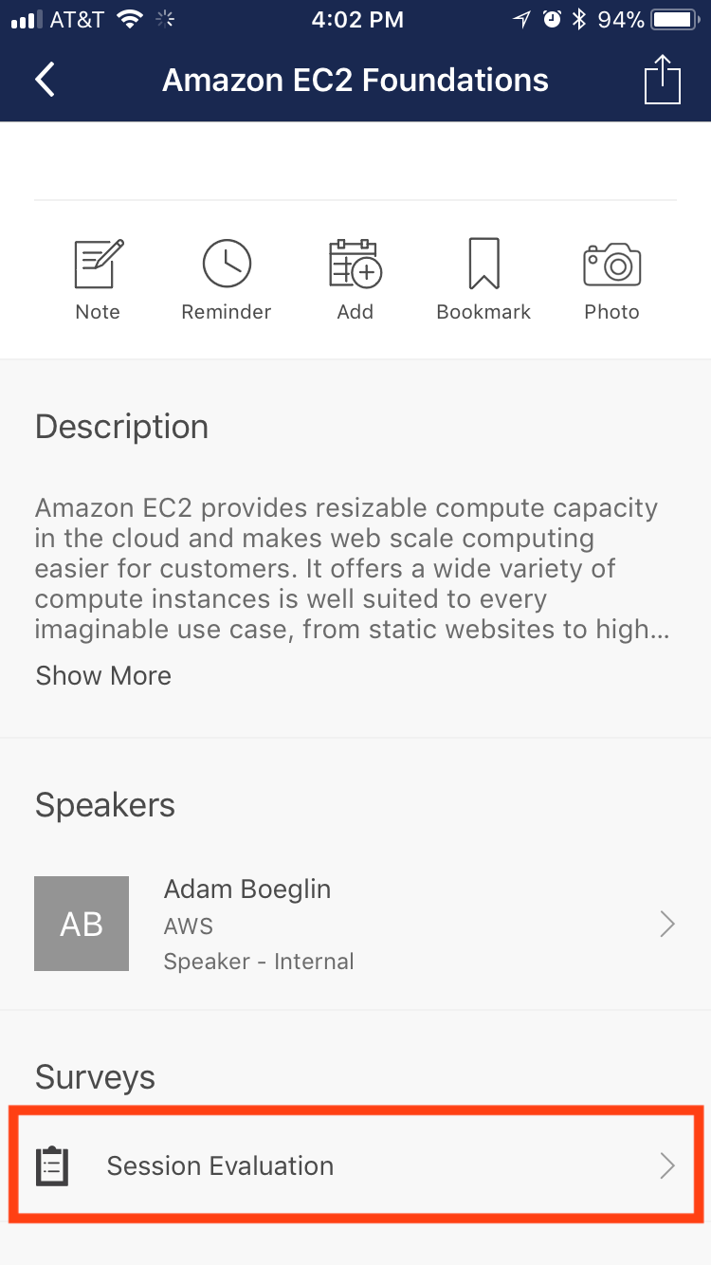
Submit Session Feedback
1. Tap the Schedule icon.
2. Select the session you attended.
3. Tap Session Evaluation to submit your feedback.

