Slide 1
Breaking Down the Monolith
Using Containers and Serverless
Nathan Peck, Senior Developer Advocate
Heeki Park, Principal Solutions Architect
September 15, 2021

Slide 2
Why containers?

Slide 3

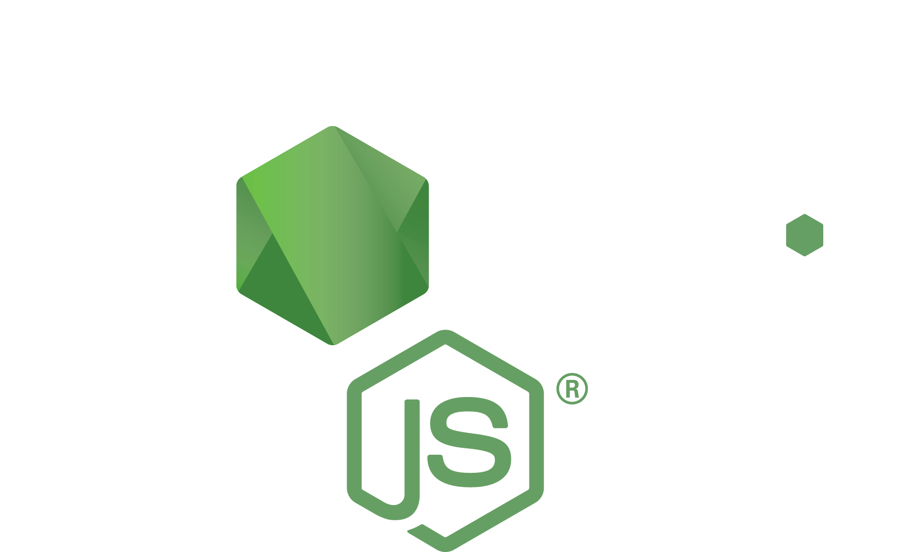


Applications aren’t just code, they have dependencies
Code packages
Operating system packages
Code
Runtime

Slide 4

Containers turn applications into one deployable artifact
Runtime
Code packages
Operating system packages
Code
Container image

Slide 5


Build
Gather the app and its dependencies. Create an immutable container image.
Push
Store the container image in a registry so it can be downloaded to compute
Run
Download image to compute, unpack it, and run it in an isolated environment

Slide 6

Breaking a monolith is scary because more services mean more dependencies
Service A
Service B
Code packages
Code
Code
PyPi packages
Operating system packages
Operating system packages
Node: 16.6.2
Python: 3.9.6

Slide 7

Containers make dependencies a decentralized job
Service A
Code packages
Code
Team A
Container A
Operating system packages
Node: 16.6.2

Slide 8
Containers make dependencies a decentralized job
Service B
Code
PyPi packages
Team B
Container B
Operating system packages
Python: 3.9.6

Slide 9

Infrastructure is now agnostic to container contents.
Container A
Container B
AWS Fargate
Different containers can be
handled the same way
using the same tooling
Container C
Container D

Slide 10
Why serverless?

Slide 11



Serverless can help simplify the execution module
Event
Lambda
Other dependent services

Slide 12

Applications can be packaged as a zip artifact
Code
Code packages
Zip file

Slide 13
Applications can also be packaged as a container artifact
Code
Code packages
Container image

Slide 14
Package dependencies separately as Lambda Layers
Lets functions easily share code: Upload layer once, reference within any function
Promote separation of responsibilities, lets developers iterate faster on writing business logic
Built in support for secure sharing by ecosystem
Notes:
One of the ways we’ve simplified writing Lambda functions it through Lambda Layers, which lets functions share code.
With Layers, developers to upload code once, and reuse it multiple times. Plus it’s got built in support for sharing by ecosystem. Sharing code this way can also help promote separation of responsibilities – someone can be responsible for managing the core library, and another for using and building on top of the library code to build application logic.
---
Lambda already lets you package your dependencies, but required you to duplicate it across every function you wrote. We also see customers adopt the pattern of thin wrappers around their core functionality across functions, and layers makes it very easy for customers to reuse code within Lambda. This also lays the foundation for us to do innovate further on behalf of the customer, with how function code gets initialized and loaded.

Slide 15
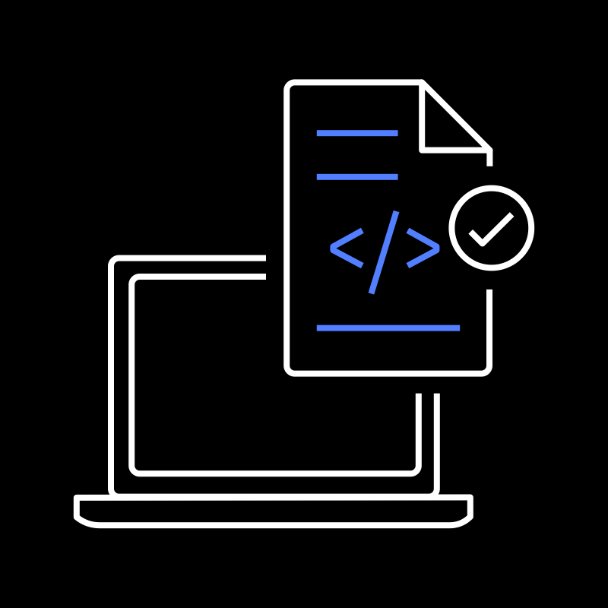



Deploy the code as resources
build
package
deploy
provision
Source Code
Build Artifacts
Templates +
Staged Artifacts
AWS CloudFormation
Cloud Resources
sam init // create new project
sam build // build artifacts
sam package // generate templates and stage artifacts
sam deploy // deploy resources
Notes:
One of the ways we’ve simplified writing Lambda functions it through Lambda Layers, which lets functions share code.
With Layers, developers to upload code once, and reuse it multiple times. Plus it’s got built in support for sharing by ecosystem. Sharing code this way can also help promote separation of responsibilities – someone can be responsible for managing the core library, and another for using and building on top of the library code to build application logic.
---
Lambda already lets you package your dependencies, but required you to duplicate it across every function you wrote. We also see customers adopt the pattern of thin wrappers around their core functionality across functions, and layers makes it very easy for customers to reuse code within Lambda. This also lays the foundation for us to do innovate further on behalf of the customer, with how function code gets initialized and loaded.

Slide 16

Run the code as a zip artifact
Execution Environment
Runtime API
Language Runtime
Lambda Function Code
Lambda Layers
(attached with packaged dependencies)

Slide 17
Run the code as a container image
Execution Environment
Runtime API
Container Image
Language Runtime
Lambda Function Code
Packaged Dependencies

Slide 18
Popular decoupling patterns with containers

Slide 19

Decouple traffic: One domain, multiple services
mycompany.com/blog/*
mycompany.com
Amazon Simple Storage Service
Users
Amazon
CloudFront
mycompany.com/api/*
AWS Fargate

Slide 20

Decouple API into microservices
mycompany.com/blog/*
Amazon Simple Storage Service
mycompany.com
mycompany.com/api/users/*
mycompany.com/api/*
Users
Amazon
CloudFront
AWS Fargate
Application Load Balancer
mycompany.com/api/order/*
AWS Fargate

Slide 21




The list of targets is managed by Elastic Container Service
Amazon Elastic Container Service
Application Load Balancer
Listener
Target Group
Listener Rule
Listen for traffic on port 80 and 443
Check to see if traffic matches a rule
If it does, then send it to a target from this group

Slide 22
Match on host
Hostname == mycompany.com
Hostname == api.mycompany.com
Match on path
Path == /api/users
Path == /api/orders
Match on header
Version == 1.0.0
User-Agent == mobile
Match on query string
?utm_source==bot
Listener Rule
Up to 100 rules

Slide 23

Decouple background workers
Job producer
Worker
Users
Application Load Balancer
AWS Fargate
Amazon Simple Queue Service
AWS Fargate

Slide 24
Use Topics and Queues for more complicated business logic
Producer
Topic
Subscription
Queue
Consumer
User signed up
Email Service
User Service
Email Queue
User deleted account
Push Notification Queue
Mobile Push Notification
Friend service
Friend request
Recommendation Queue
Recommendation Service
Message service
DM was sent

Slide 25
User team is responsible for web API and their own topics
User Team
User Service
user signed up
user deleted account
Email Team
Subscription
Email team is responsible for their worker service, queue, and the subscriptions to topics they are interested in.
Email Queue
Email Service

Slide 26


Decouple scheduled tasks from the monolith
Amazon EventBridge
Every day at 5:00
AWS Fargate

Slide 27
Popular decoupling patterns with serverless

Slide 28





Lambda can be invoked via three different methods
All methods deliver an event payload
Synchronous
Asynchronous
Poll-Based
Amazon
SNS
Amazon DynamoDB
Amazon
API Gateway
Amazon
S3
Amazon Kinesis
/order
reqs
Changes
event
event
AWS Lambda Service
Lambda Function
Lambda Function
Lambda Function
event
Notes:
https://docs.aws.amazon.com/lambda/latest/dg/invoking-lambda-functions.html
When you invoke a function, you can choose to invoke it synchronously or asynchronously. With synchronous invocation, you wait for the function to process the event and return a response. With asynchronous invocation, Lambda queues the event for processing and returns a response immediately. For asynchronous invocation, Lambda handles retries and can send invocation records to a destination.
To process items from a stream or queue, you can create an event source mapping. An event source mapping is a resource in Lambda that reads items from an Amazon SQS queue, an Amazon Kinesis stream, or an Amazon DynamoDB stream, and sends them to your function in batches. Each event that your function processes can contain hundreds or thousands of items.

Slide 29
API-Driven Use Cases
Full day content
Also event driven, synchronously processed
Notes:
Streams, Topics, and Queues

Slide 30



RESTful Microservices
Highly-scalable microservices
AWS Cloud
1
2
Amazon
API Gateway
AWS
Lambda
Amazon
DynamoDB
API Gateway “translates” incoming HTTP request to event payload
Lambda reads / writes data from data store

Slide 31


RESTful Microservices with enhanced observability
Enable access logs, structured logging, and instrument code
AWS Cloud
Amazon
API Gateway
AWS
Lambda
Amazon
DynamoDB
2
1
AWS X-Ray
Amazon
CloudWatch
Enable access logs and tracing
Instrument code and create metrics asynchronously with CloudWatch Embedded Metric Format
Notes:
Billy

Slide 32
Event-driven Use Cases
Full day content
Streams, Topics, and Queues
Notes:
Streams, Topics, and Queues

Slide 33
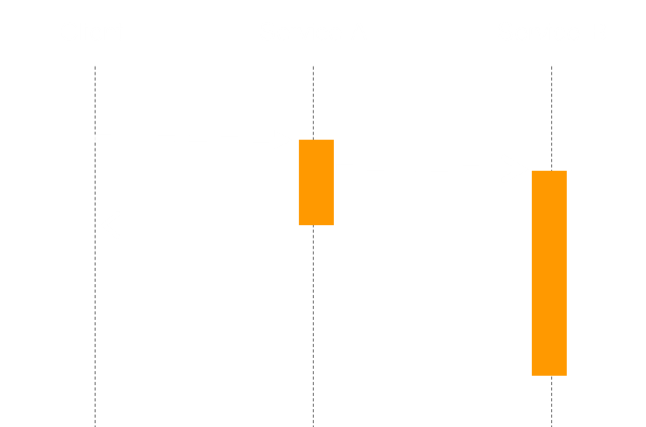
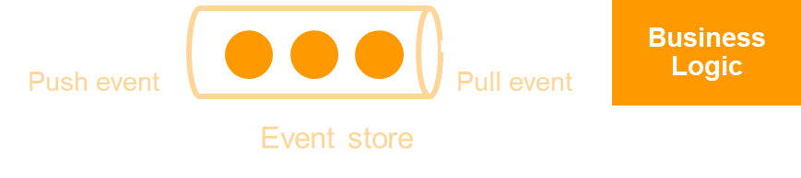
Event-driven architectures drive reliability and scalability
Event Routers
Asynchronous Events
Event Stores
Abstract producers and consumers from each other
Improve responsiveness and reduce dependencies
Buffer messages until services are available to process
Notes:
Rationalizing your serverless architecture requires that you think about event sources and how serverless functions can be activated.
Events are asynchronous – you don’t need to wait for a response to move on to the next step. This improves resilience and reduces dependencies.
The tools of event driven architectures are routers that abstract producers and consumers from each other. You can publish to the router, or and consume from it without knowledge of other producers or consumers. Event routers at AWS include EventBridge and SNS.
Event stores act as buffers, holding onto events until the consumer is ready to use them. At AWS SQS is our serverless event store, or queue. Amazon MQ is another queue, and it uses standard APIs and protocols (eg. JMS, NMS, AMQP, STOMP, MQTT, and WebSocket.)

Slide 34


Processing file uploads
Resize photo, extract text, translate, etc.
Object uploaded to Amazon S3 Bucket
Asynchronous invoke of Lambda function, event payload includes:
  Bucket name
  Object key
1
2
Notes:
Storage for the Internet
Objects stored in a bucket (namespace)
Messages can be filtered and only sent to certain paths, prefixes, or suffixes
Asynchronous

Slide 35

Processing file uploads, quickly add new functionality
Add image analysis and metadata storage
Analyze photo with Amazon Rekognition
Store image details and results of analysis
1
2
3
Amazon
Rekognition
4
Amazon
DynamoDB
Notes:
Billy

Slide 36

Streaming data ingestion and storage
Consume, process, and store data
1
2
Amazon
Redshift
3
Amazon
Kinesis
AWS Lambda
Amazon S3
Lambda service polls Kinesis Data Stream for messages
Function is synchronously invoked with batches of messages
Function processes and/or pushes data to downstream data stores
Notes:
Billy

Slide 37
Fan out
Push updates to multiple subscribers
“Storage first”: integrate API Gateway directly to EventBridge
Enforce authorization
Use routing for efficient processing
Multiple consumers w/ DLQ
Status=Created
Amazon SQS
Consumer
1
3
Status=Processed
Amazon API
Gateway
Amazon
EventBridge
Amazon SQS
Consumer
2
Status=Refunded
Custom
authorizer
Amazon SQS
Consumer
DLQ
Notes:
Also mention EventBridge

Slide 38
Decoupling with containers for security

Slide 39


Containers can have their own security groups and IAM roles
Networking control
Security Group
Amazon VPC
Container A
API level control
AWS Identity and Access Management
Amazon Simple Storage Service

Slide 40



Control access to databases on a service by service basis
Security Group
Container A
Amazon RDS
Security Group
Container B

Slide 41
Control access from one service to another
Security Group
Security Group
Container B
Container A
Security Group
Container C

Slide 42
Control API level actions for services
IAM Role
IAM Role
Amazon Simple Queue Service
Job Consumer
Job producer
Producer is allowed to add items to queue, but not read queue
Consumer is allowed to read queue but not add jobs

Slide 43
Practical decoupling tips

Slide 44

Practical decoupling: from monolith to micro
Functioning monolith

Slide 45






Trying to break things up too fast is a recipe for disaster
Kind of works?
Buggy service
Semi-functioning microservice
Boom!
Broken implementation
This part works great!

Slide 46


Decouple gradually, leave the central monolith for a while
Efficient microservice
Well functioning service
Functioning monolith

Slide 47
Some practical places to start: User signup
Password storage and hashing
Password database
Core API
Main database

Slide 48

Some practical places to start: User signup
Password storage and hashing
Password database
Queue
Emailer Service
Core API
Worker service
Main database

Slide 49
Look for transactions that have longer than average response time, or different resource needs:
Social media application
  Contact list upload, and server side contact matching (Big payloads)
  Friend recommendations (Heavy queries, lots of data)
Store
  Product recommendation (Training models)
  Payment processing (Need to keep payment details safe)
Media
  Upload processing, media transcoding (Heavy CPU, bandwidth)
  Server side image resizing (Heavy CPU, bandwidth)

Slide 50
Decouple workloads responsibly. It is okay to have a central monolith
Microservice
Database
Scheduled cron job
Queue
Worker
Core API

Slide 51
Thank you!

