Slide 1
Chaos in Containers Unleashing Resilience
Nathan Peck
Senior Developer Advocate
Amazon Web Services

Slide 2
Notes:
The perfect Turing machine

Slide 3
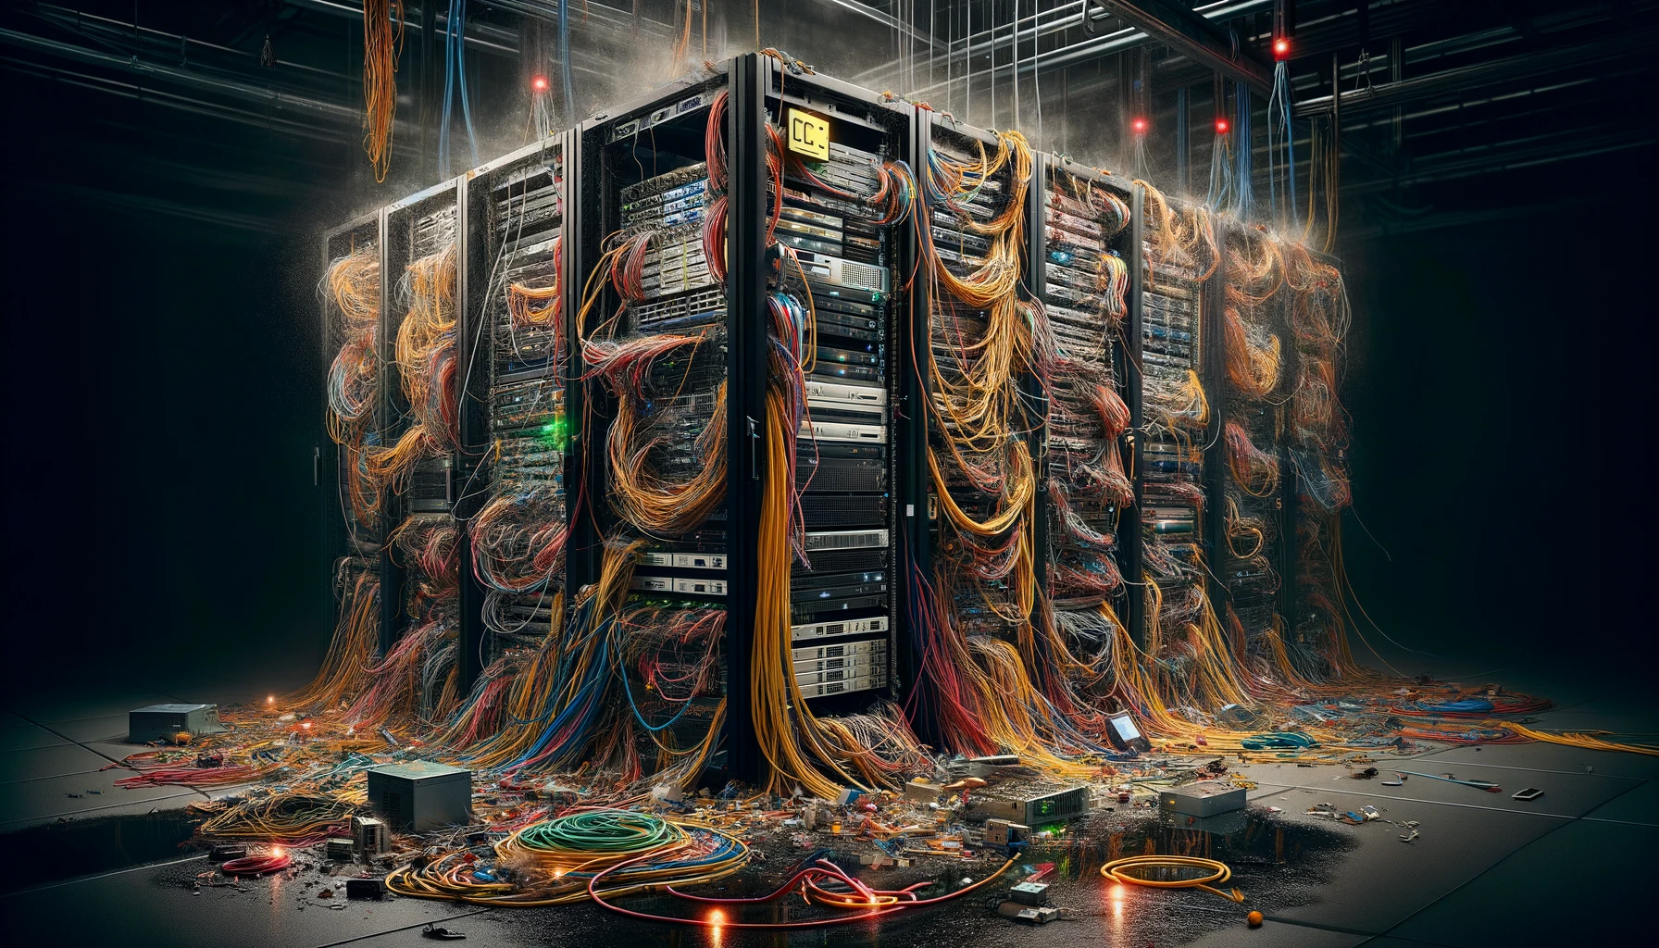
Notes:
Reality!

Slide 4
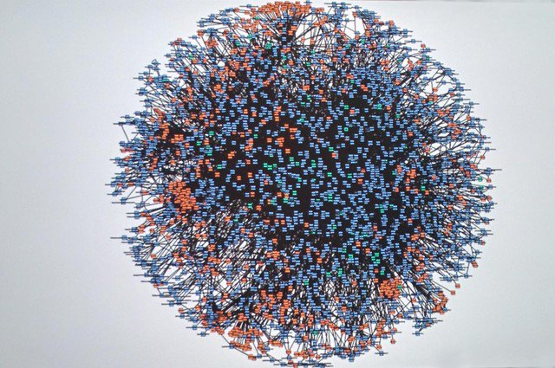
2024
2008

Slide 5
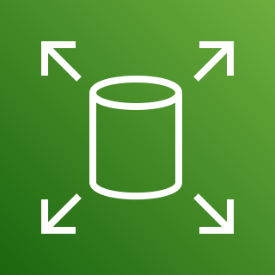
Amazon Web Services on Prime Day 2023
163 Petabytes of data
15.3 trillion requests peak
764 petabytes of data transfer
86 million messages per second peak
Amazon Elastic Block Store (Amazon EBS)
Amazon Simple Queue Service (Amazon SQS)
126 million requests per second peak
500 million requests per minute peak
Over 1 trillion requests total
Amazon DynamoDB
Amazon CloudFront

Slide 6
“Chaos is always losing, but never defeated” - Alan Watts

Slide 7
Chaos is a spectrum
The closer you get to the right hand side, the better!
The application is completely down
Application is so slow it is barely usable
Only one application feature is broken
Application is functioning perfectly
Redundancy reduces the impact of chaos

Slide 8
The Load-bearing Laptop
One of your business processes is being run from an employee laptop that sits on their desk
Coffee could spill on laptop and fry it
“Don’t power off” sign falls off, cleaners unplug the laptop by accident

Slide 9
The IT Closet
Application runs on a machine that sits in a closet in the office.
What if the office electricity goes out or internet connection goes down?
What if dust builds up and that machine overheats?

Slide 10
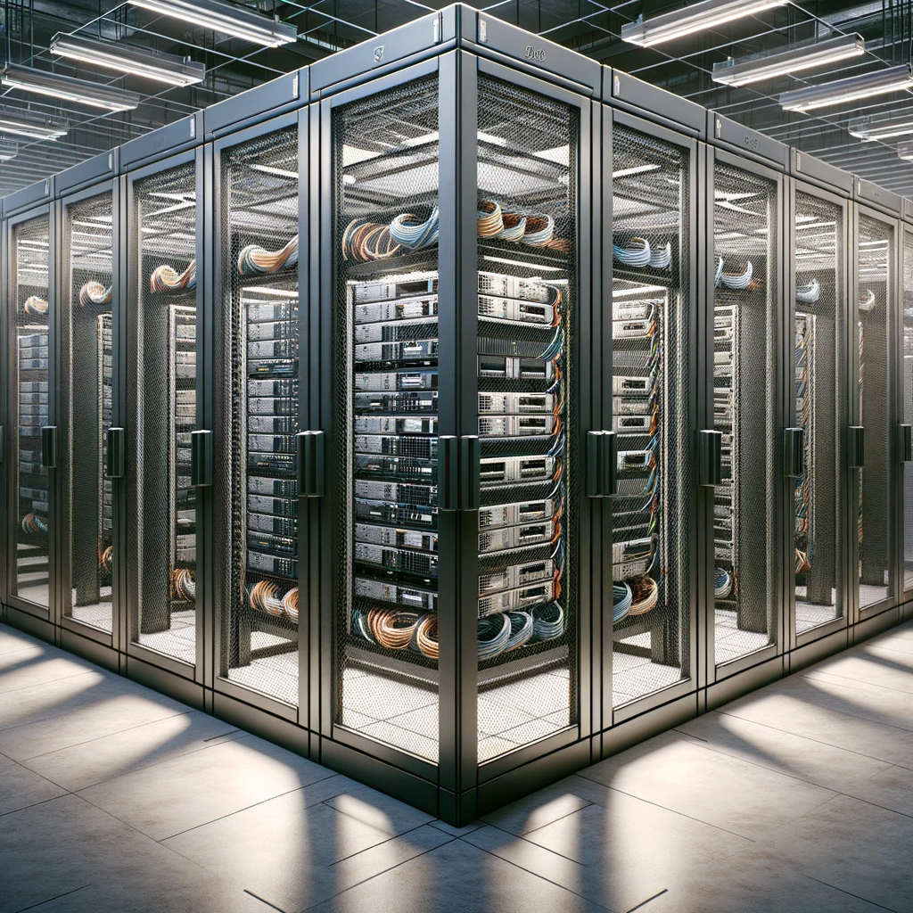
The Collocation Facility
Application runs on a server in a professional collocation facility. Data is stored on the racked server.
Does this facility offer redundant internet and power?
What if my server hardware fails?
What if a neighboring rack catches fire? What if the fire suppression system fails and this entire collocation facility burns down?

Slide 11
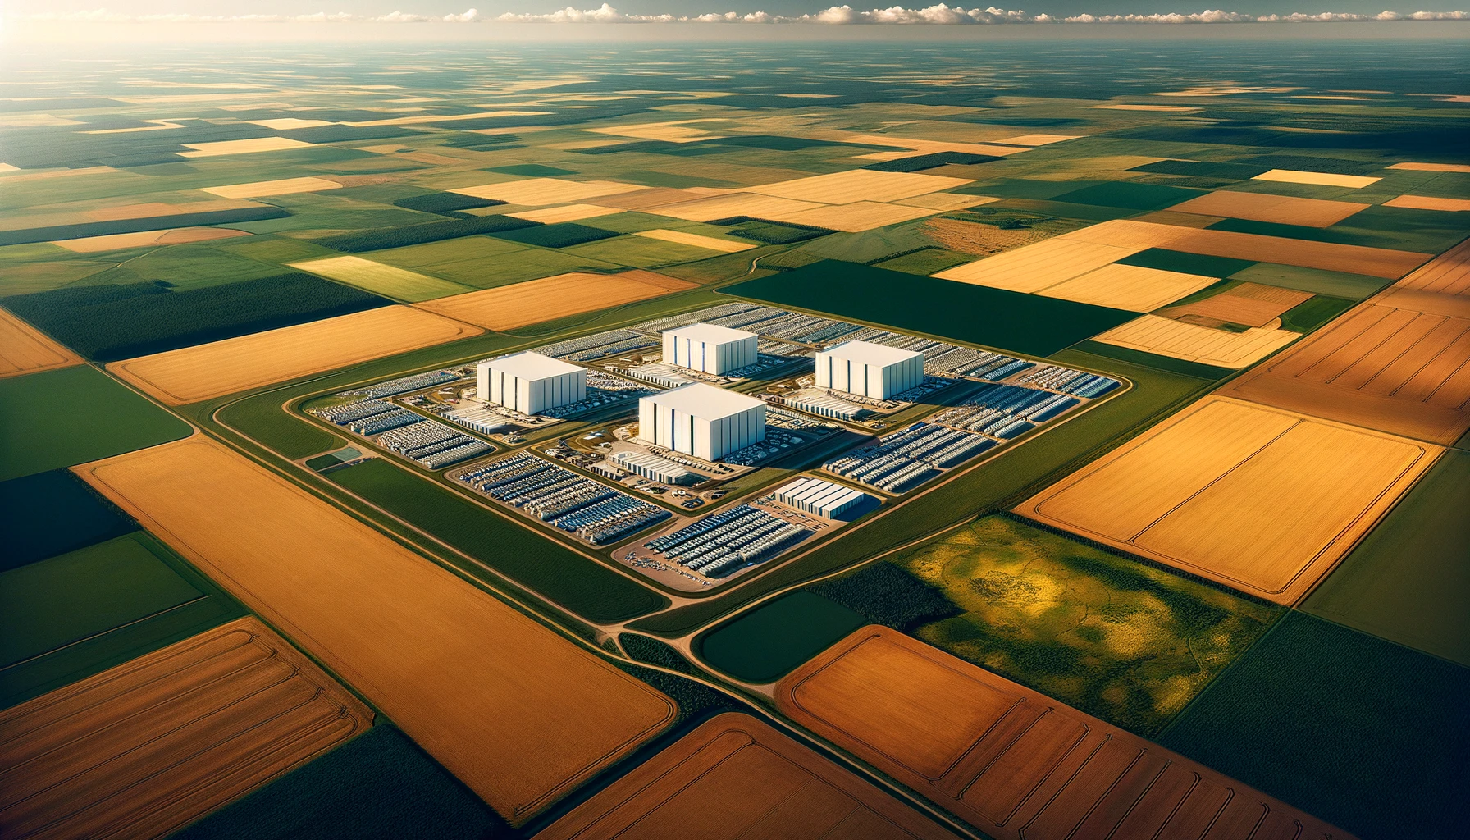
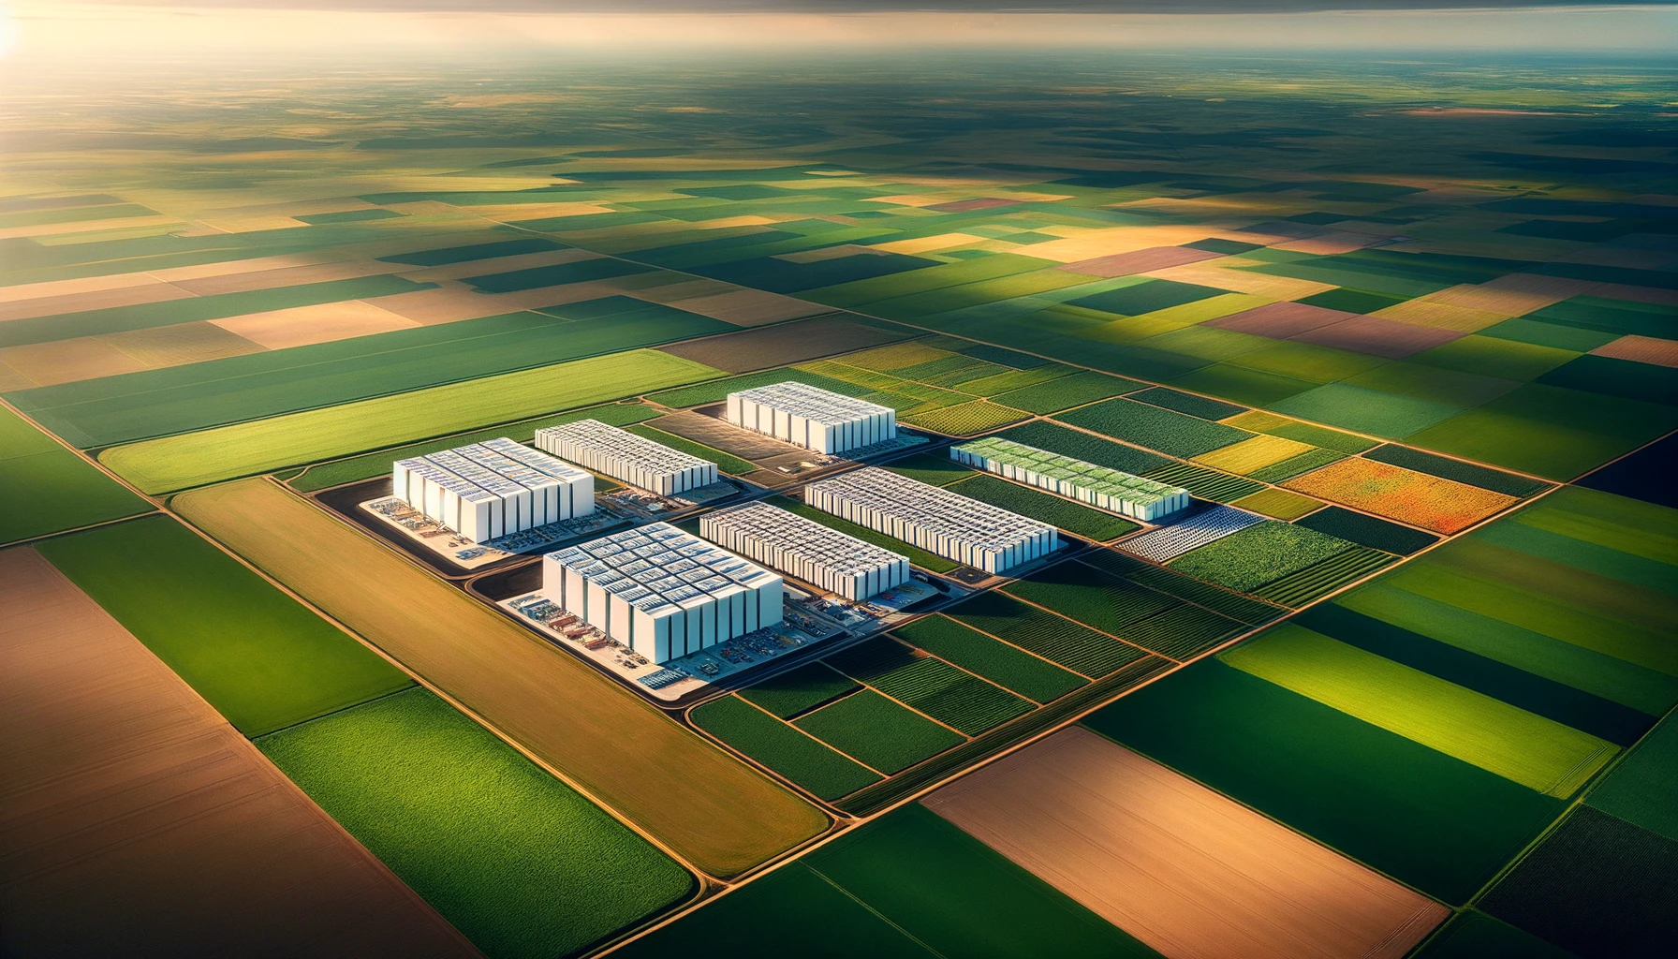
Cloud Deployment
Application and data are now replicated across multiple redundant pieces of hardware distributed across multiple data centers separated by up to 50 miles. Each availability zone has it’s own redundant backup power generation, fire suppression systems, cooling, etc.

Slide 13
A resiliency paradox
The more distributed your software system is:
the more resilient it is against catastrophic failures and data loss
BUT:
the more independent pieces there are which can fail
the more vulnerable it is to connectivity failures between the distributed pieces

Slide 14
“The more a thing tends to be permanent, the more it tends to be lifeless” - Alan Watts

Slide 15
Embrace the idea of ephemeral computing
Ephemeral means:
Computers aren’t special pets, they are just capacity
We can turn off any computer in the rack, or it can break suddenly, and your application keeps functioning

Slide 16
Containers enable ephemerality
Runtime
Code packages
Operating system packages
Code
Container image

Slide 17
From description to container deployment
1 x vCPU
2 GB memory
Amazon Elastic Container Service
Here is my container image. It needs 1 CPU and 2 GB of memory to run. I want to launch 4 copies of it as a distributed service.
The container is your unit of deployment.
Compute hardware that runs a container is just “dumb” capacity
(Orchestrator)

Slide 18
An orchestrator automatically deploys containers across distributed infrastructure
Production Cluster
EC2 Instance
EC2 Instance
EC2 Instance
Docker (containerd)
Docker (containerd)
Docker (containerd)
Orchestration Agent
Orchestration Agent
Orchestration Agent
Blue Container
Blue Container
Purple Container
Available capacity
Blue Container
Available capacity

Slide 19
Orchestrator replaces crashed or lost containers to maintain availability
production
The hardware failed, and all containers on this computer were lost. They must be replaced on another piece of hardware.
EC2 Instance
Terminated EC2 instance
Docker (containerd)
Docker (containerd)
One container crashed and must be restarted
Orchestration Agent
Orchestration Agent
Crashed Container
Your Task Container
Your Task Container
Available capacity

Slide 20
Orchestrator monitors health probes against running containers, replaces unhealthy containers
Traffic port is monitored from outside. Is the web server accepting requests? Is it timing out, or responding with a status code that indicated failure?
EC2 Instance
Docker (containerd)
Orchestration Agent
Health check command is run from inside of the local hardware
Your Task Container

Slide 21
Orchestrator shifts web traffic as containers start, stop, and restart on different hardware
Update list of targets in load balancer as containers start and stop
Application Load Balancer
Amazon Elastic Container Service
Listener
Target Group
Running Container
Running Container
Web Users
Stopping Container
ECS safely drains traffic when stopping a container

Slide 22
The map of chaos reduction so far…
Problems
Solutions
Hardware Infrastructure
Redundancy
Distribution
Software Deployment
Ephemerality
Orchestration
Code Implementation
Here be dragons (and many bugs)

Slide 23
“The only real mistake is the one from which we learn nothing” - Henry Ford

Slide 24
Chaos Engineering Flywheel
Steady state
Improve
Hypothesis
Verify
Run experiment

Slide 25
Intentional fault injection finds flaws early
AWS Fault Injection Simulator
Your Application
Measurements
Corrective Action
Chaos Monkey from Netflix

Slide 26
Common fault scenarios you can inject
Network traffic “black hole”
Network traffic latency
Network traffic packet loss
Network partitions (one large network divides into two)
Resource saturation: CPU, memory, I/O. Thundering herd.
Sudden hardware failure

Slide 27
It’s a mystery!
I’ve seen this before

Slide 28
Correction of error document
What happened? What was the impact?
What were the root causes? Ask “why” at least five times.
What data do you have to support this?
What lessons did you learn?
What corrective actions are you taking?

Slide 29
A healthy culture of fault correction
Blameless, the goal isn’t to punish, it is to improve
Learnings from faults are shared widely across the organization
Corrective mitigations for faults are codified as guardrails against future faults

Slide 30
“Do not be dismayed by the brokenness of the world. All things break. And all things can be mended. Not with time, as they say, but with intention.” - L.R. Knost

Slide 31
Chaos engineering is the idea that resilience is best achieved by learning from intentional chaos
Problems
Solutions
Hardware Infrastructure
Redundancy
Distribution
Software Deployment
Ephemerality
Orchestration
Code Implementation
Fault Injection Experiments
Correction of Error Culture

Slide 32
Nathan Peck
@nathankpeck
peckn@amazon.com

