Slide 1
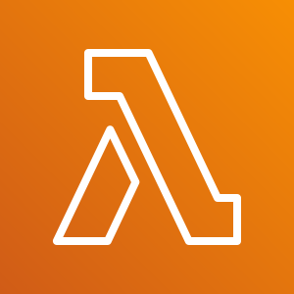
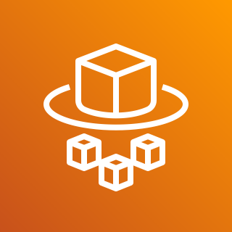
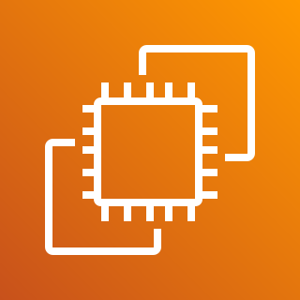
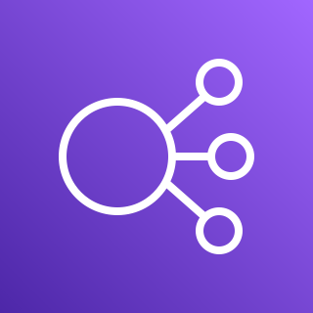
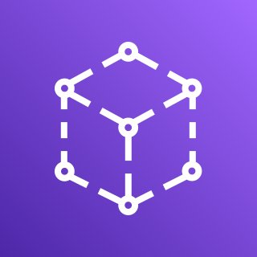
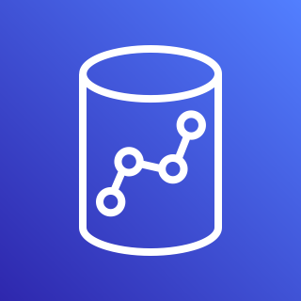
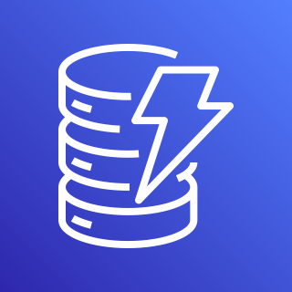
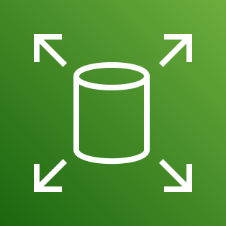
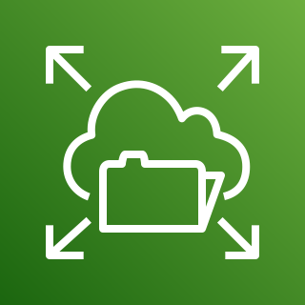
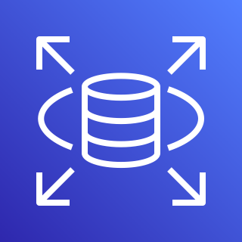
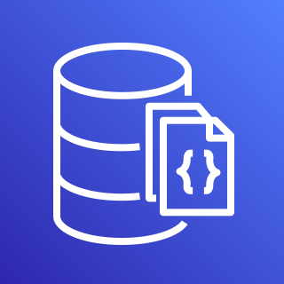
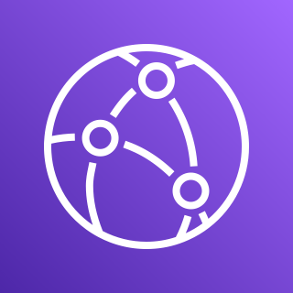
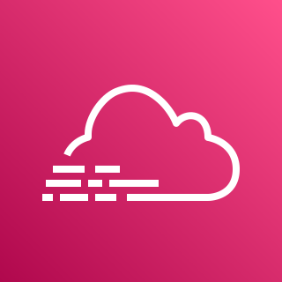
The Gamer Guide
to Playing AWS

Slide 4
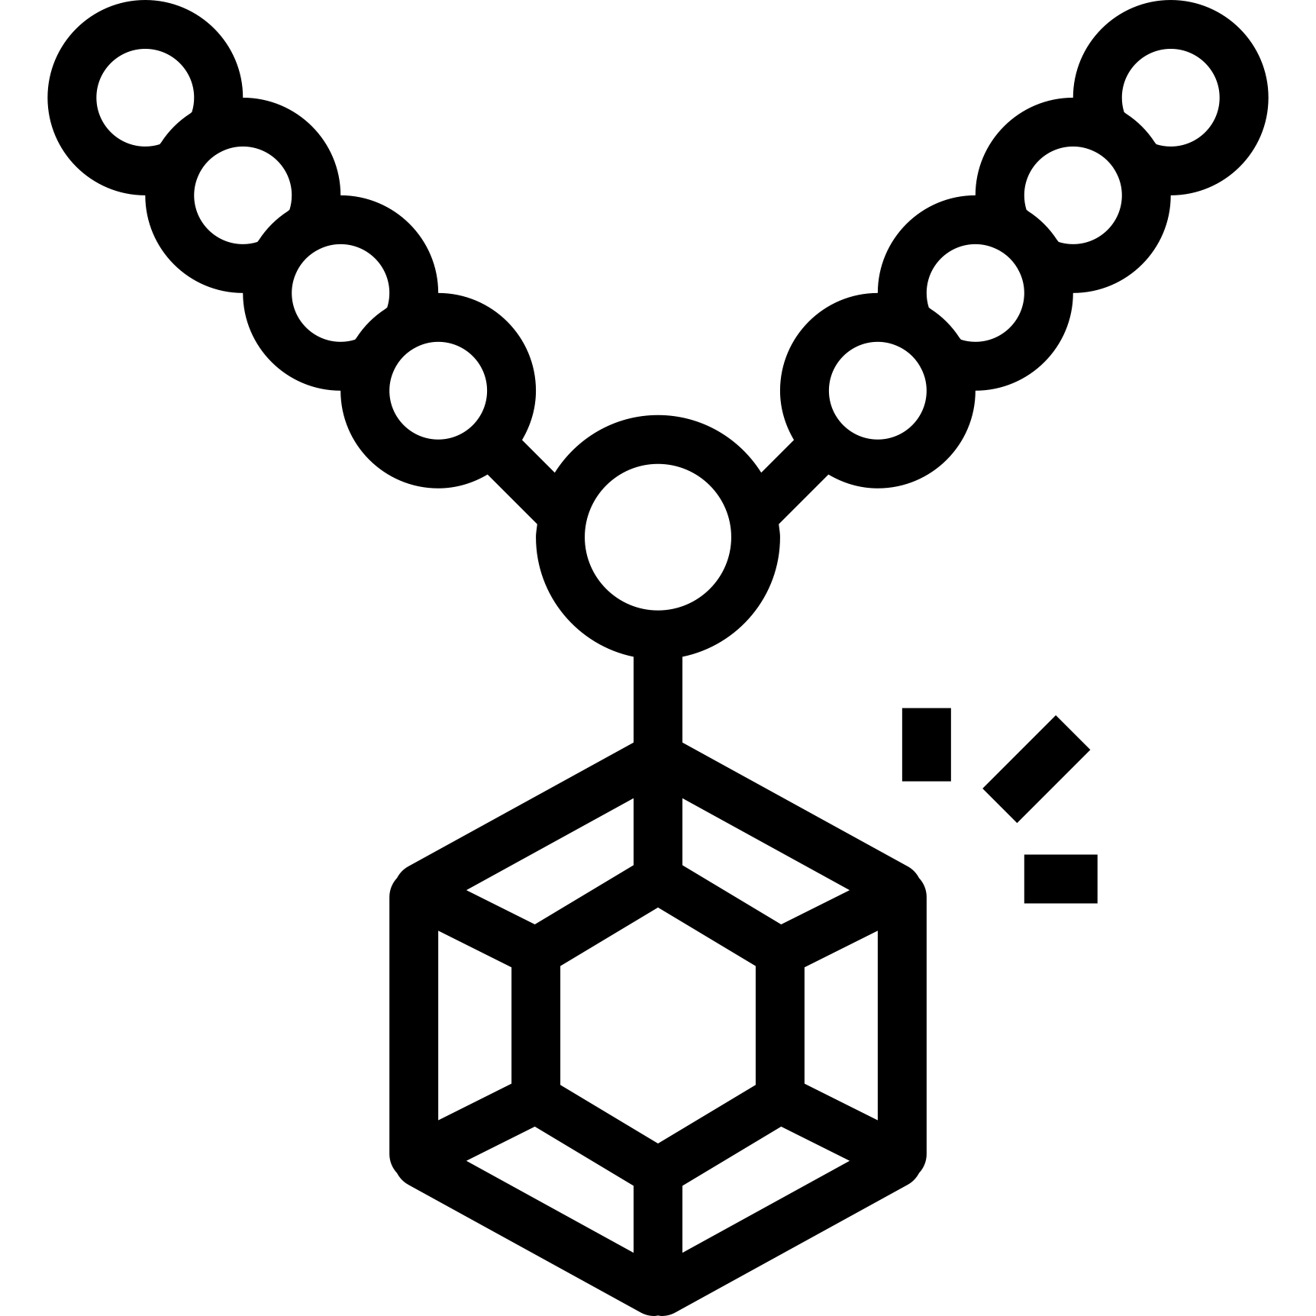

Slide 5
Amazon Redshift
Amazon DynamoDB
Amazon RDS
Amazon DocumentDB (with MongoDB compatibility)
Amazon Simple Storage Service (S3)
Amazon Elastic Block Store (Amazon EBS)
Amazon Elastic File System (Amazon EFS)

Slide 6
AWS Lambda
AWS Fargate
Amazon EC2
Amazon Lightsail
AWS App Runner

Slide 7
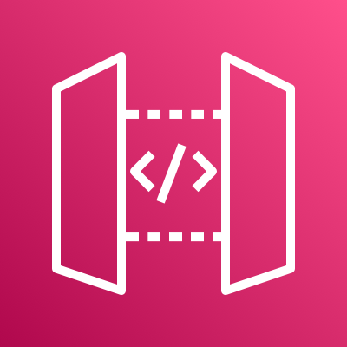
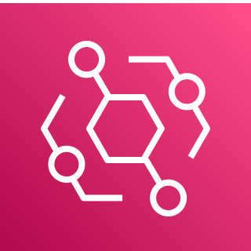
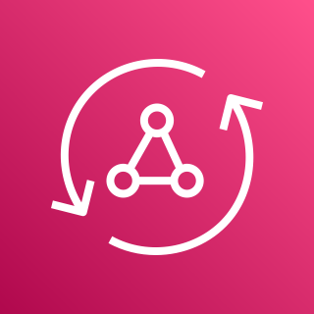
Elastic Load Balancing
AWS App Mesh
Amazon CloudFront
Amazon Route 53
Amazon API Gateway
Amazon EventBridge
AWS AppSync

Slide 8
Amazon CloudWatch
AWS CloudTrail
Amazon Managed Service for Grafana
Amazon Managed Service for Prometheus
AWS Distro for OpenTelemetry
AWS X-Ray

Slide 9
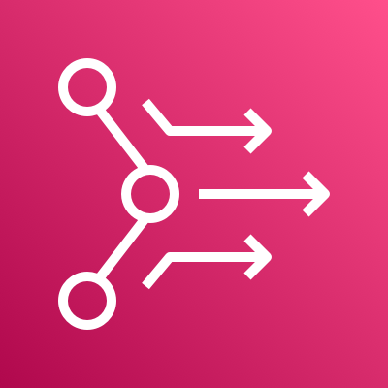
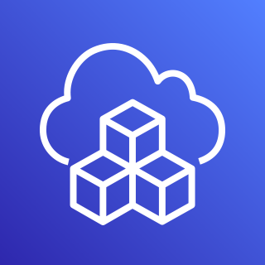
Amazon Elastic Container Service (Amazon ECS)
Amazon Elastic Kubernetes Service (Amazon EKS)
AWS Proton
AWS CloudFormation
AWS Systems Manager
AWS Cloud Development Kit (AWS CDK)

Slide 10
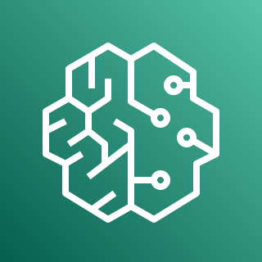
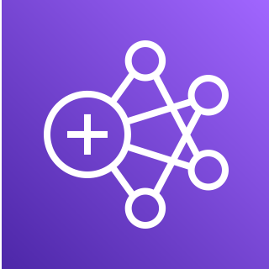
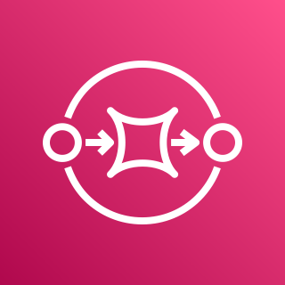
Amazon SageMaker
AWS IoT Core
Amazon EMR
Amazon Simple Notification Service (Amazon SNS)
Amazon Simple Queue Service (Amazon SQS)

Slide 11
Amazon CloudWatch
AWS AppSync
Amazon API Gateway
AWS Amplify
Amazon Simple Queue Service (Amazon SQS)
AWS Lambda
Amazon DynamoDB

Slide 12
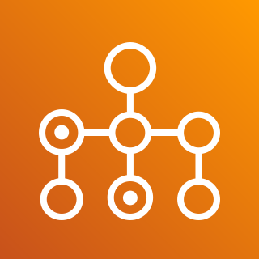
AWS Distro for OpenTelemetry
AWS Batch
AWS App Mesh
Amazon Elastic Container Service (Amazon ECS)
Amazon Elastic Container Registry (Amazon ECR)
AWS Fargate
Amazon Elastic File System (Amazon EFS)

Slide 13
Amazon CloudWatch
Amazon CloudFront
Elastic Load Balancing
AWS CloudFormation
Amazon Simple Storage Service (S3)
Amazon EC2
Amazon RDS

Slide 14
AWS Distro for OpenTelemetry
Amazon Elastic Container Registry (Amazon ECR)
Elastic Load Balancing
Amazon Elastic Kubernetes Service (Amazon EKS)
Amazon Managed Service for Prometheus
Amazon EC2
Amazon Elastic Block Store (Amazon EBS)

Slide 15
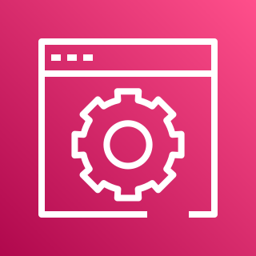
Amazon CloudWatch
Amazon Elastic Container Registry (Amazon ECR)
Amazon Lightsail
AWS Console
Amazon Lightsail
Container Service
Amazon Lightsail
Database

