Slide 1
Getting Started with Docker
on AWS
Nathan Peck, Developer Advocate for Container Services
March 21, 2018

Slide 2
Why Docker containers?
FizzBuzz!

Slide 3
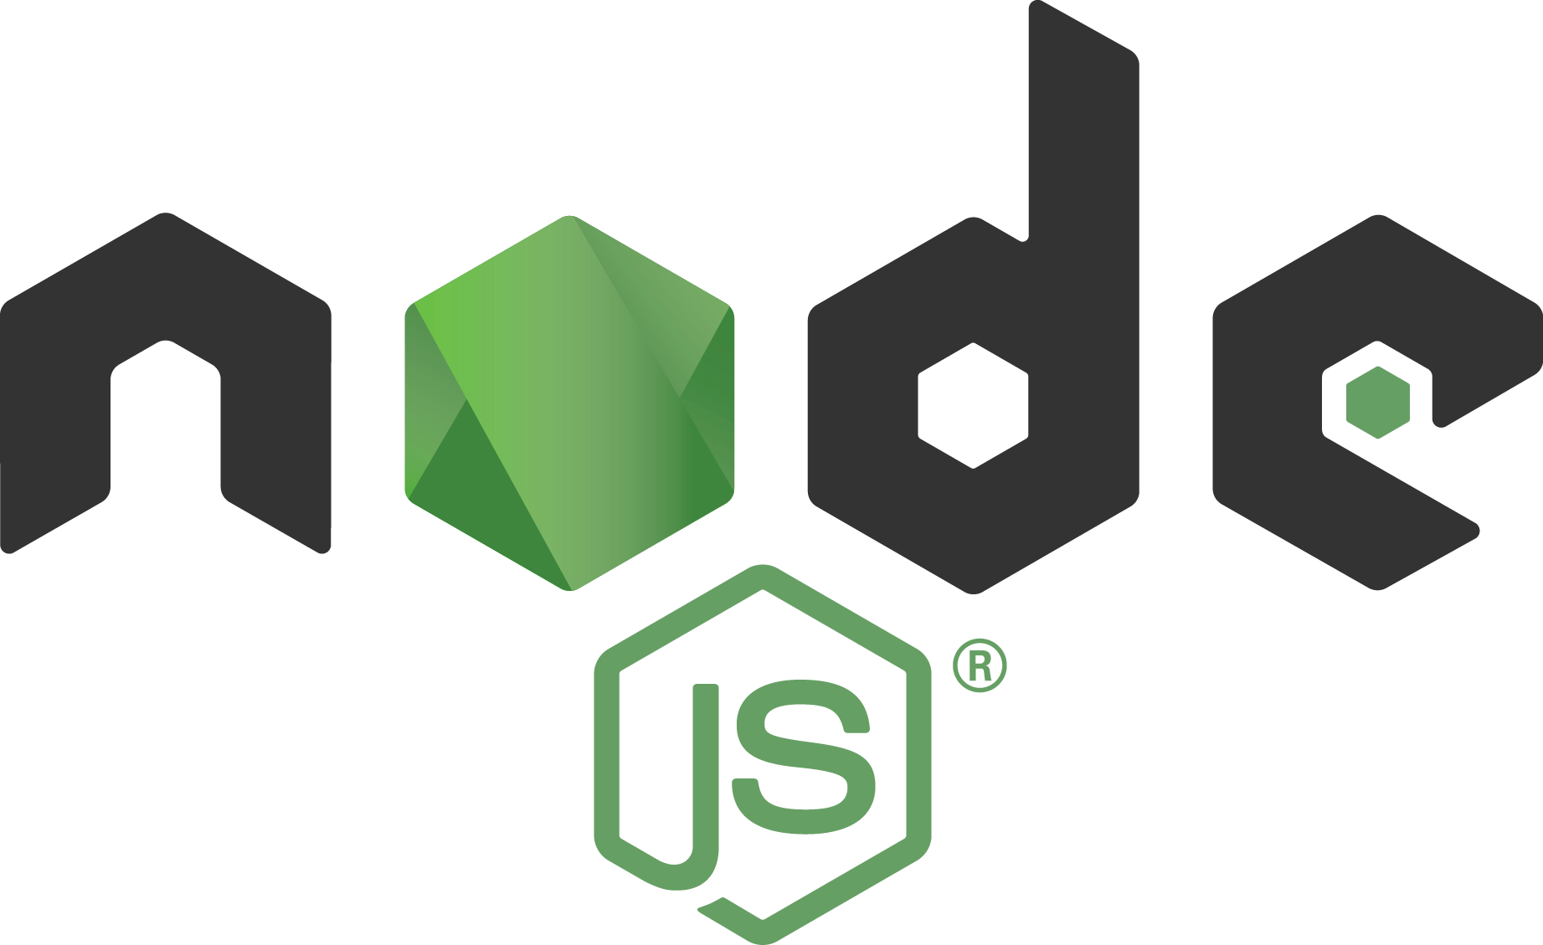

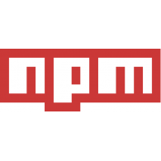
Application environment components
Runtime Engine
Code
Dependencies

Slide 4

Different environments
Local Laptop
Staging / QA
Production
On-Premise

Slide 5
It worked on my machine, why not in production?
v6.0.0
v7.0.0
v4.0.0
v7.0.0
Local Laptop
Staging / QA
Production
On-Prem

Slide 6
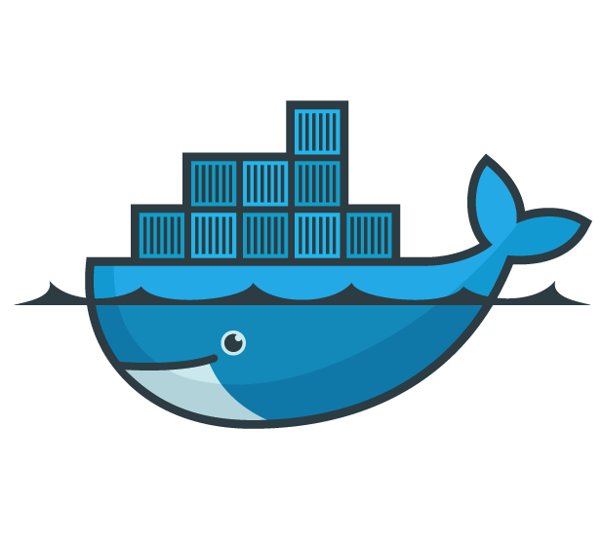
Docker
Lightweight container virtualization platform.
Licensed under the Apache 2.0 license.
First released March 2013
Built by Docker, Inc.
Notes:
Docker is a platform designed to help automate deployment of application containers.
It was built by the Docker, Inc., who were previously “DotCloud”, a PaaS platform.

Slide 7
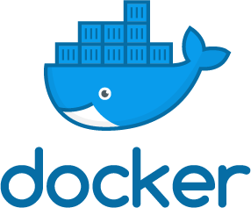
docker build

Slide 8
Docker Image
Read only image that is used as a template to launch a container.
Start from base images that have your dependencies, add your custom code.
Docker file for easy, reproducible builds.
Writable
add nginx
Container
add nodejs
Image
References
parent
image
Ubuntu
Image
Base image
bootfs
kernel

Slide 9

docker push
Container Registry
(Private or Public)

Slide 10
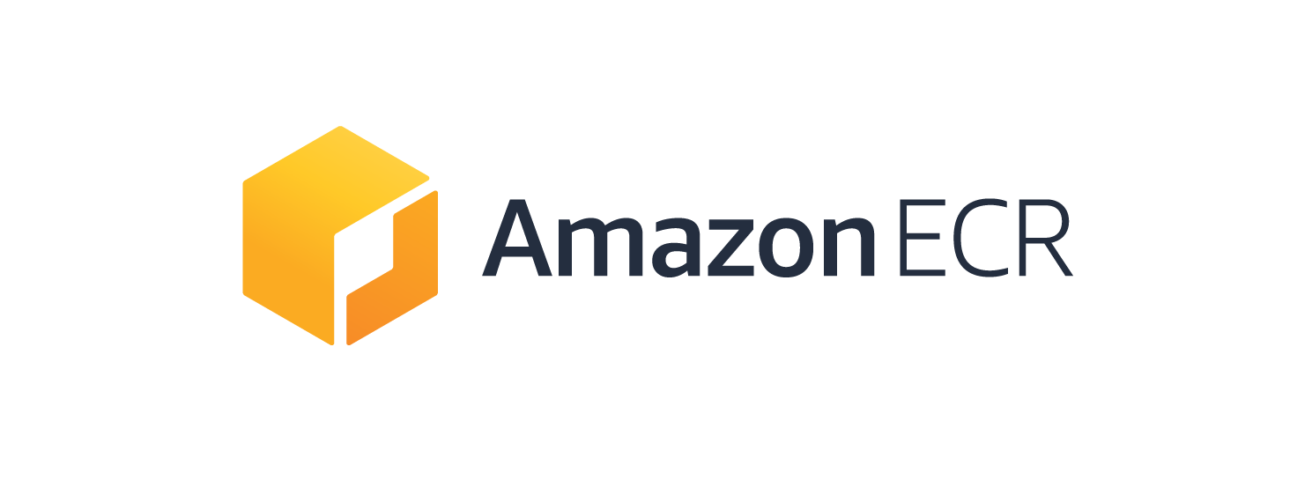
Amazon Elastic Container Registry (Amazon ECR)
Cloud-based Docker image registry
Fully managed
Secure – images encrypted at rest, integrated with IAM
Scalable and Highly Available
Integrated with Amazon ECS and the Docker CLI
Notes:
If you want to store your container images in the cloud, Amazon ECR is a managed docker image registry that is secure, highly available and integrated with Amazon ECS and the Docker CLI.

Slide 11
docker run
Development
Container Registry
(Private or Public)
Production

Slide 12
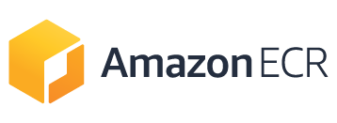
docker build
docker run
docker push

Slide 13
Four environments, same container
Local Laptop
Staging / QA
Production
On-Prem

Slide 14
One machine, multiple containers
Foo App
Bar App
Performance & Cost Savings

Slide 15
VM vs Container
VM
App 1
App 2
App 3
Container
Bins/Libs
Bins/Libs
Bins/Libs
App 1
App 2
App 3
Guest OS
Guest OS
Guest OS
Bins/Libs
Bins/Libs
Bins/Libs
Hypervisor
Docker
Host OS
Host OS
Server (Host)
Server (Host)

Slide 16
Benefits
Portable runtime application environment
Package application and dependencies in a single artifact
Run different application versions (different dependencies) simultaneously
Faster development & deployment cycles
Better resource utilization

Slide 17
Use Cases
Consistent environment between Development & Production
Service-Oriented Architectures & Microservices
Short lived workflows, batch jobs, cron jobs
Isolated environments for testing
Notes:
Makes it easier to build & deploy things more rapidly, because the environment is the same. Build the container in dev, push to test, release to prod. This can also be useful for customers running hybrid environments.
Makes it easier to keep consistent environments for SOAs or Micro-Services. Also, many of these services aren’t very resource intensive, so you can place them together on one instance.
Sometimes customers have short-lived workflows that need to setup environments (e.g. queue systems, CI jobs, etc.), which doesn’t always map too well to EC2’s per-hour billing model. Docker can be one workaround, allowing them to push & pop containers on to the instance.
Can be useful for isolated execution when testing user code. E.g. Go Playground or similar.

Slide 18
One monolithic container, a couple hosts

Slide 19
A couple containers on a few hosts

Slide 20
Many containers, many hosts

Slide 21
How do I manage containers across many hosts?

Slide 22
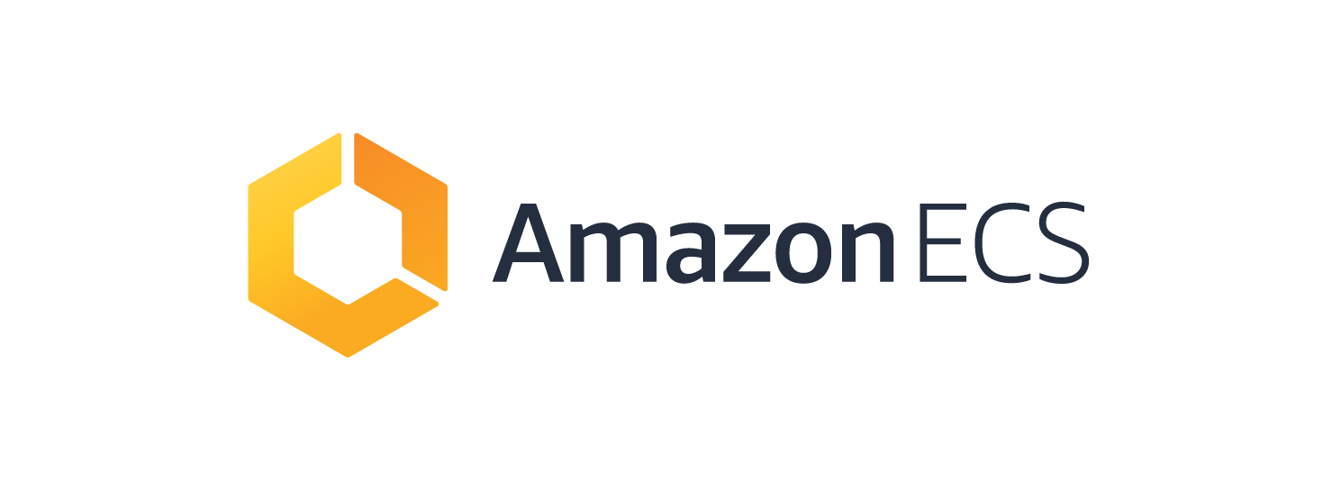

Slide 23
Amazon Elastic Container Service (Amazon ECS)
Container management service
Fully managed
Scalable and Highly Available
Microservices, batch workers, machine learning applications
Integrated with
  Amazon ECR
  AWS networking, storage, management tools
  AWS Fargate

Slide 24
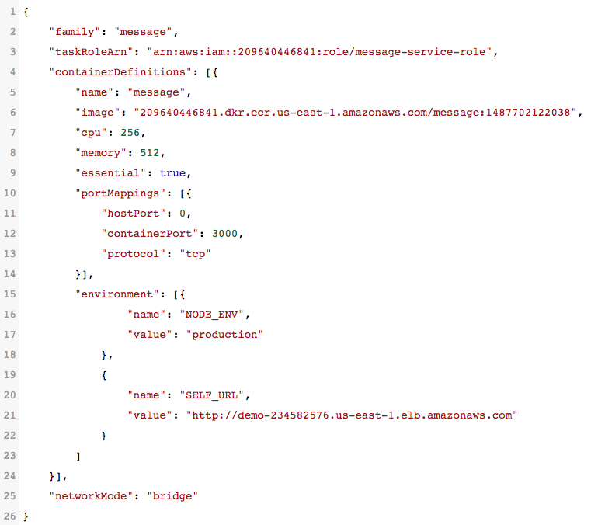
Task Definition
Container to run
CPU and Memory Needs
Networking details, Ports
Environment Variables

Slide 25
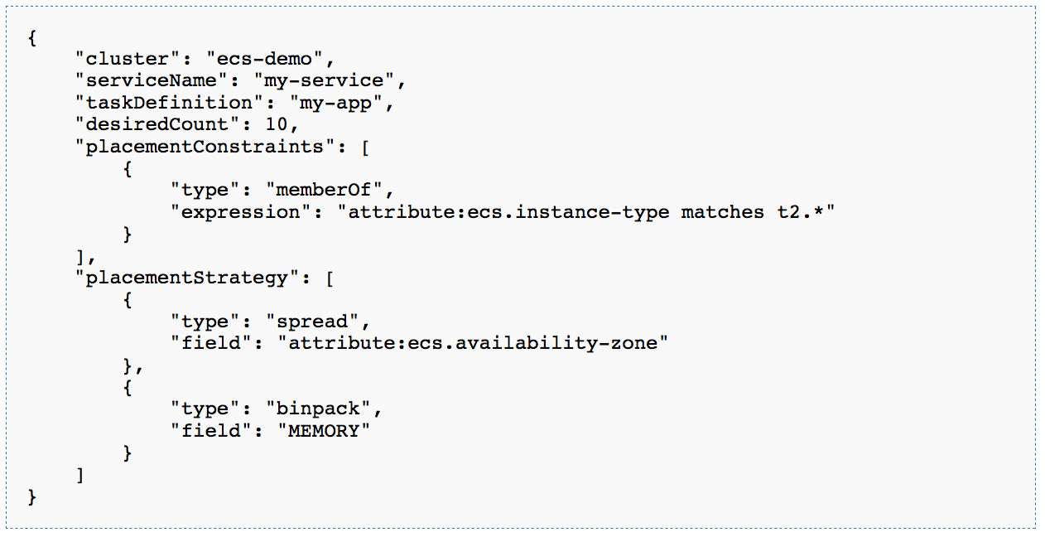
Service Definition
Notes:
aws ecs describ-service --cluster ecs-demo --name my-service

Slide 26


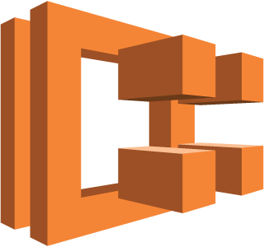

Amazon ECS
EC2 instances
TASK
TASK
ecs
agent
Internet
LOAD
BALANCER
Container
Container
Amazon ECS
TASK
TASK
ecs
agent
Container
Container
Agent Communication Service
API
TASK
TASK
ecs
agent
CLUSTER MANAGEMENT ENGINE
LOAD
BALANCER
Container
Container
KEY/VALUE STORE

Slide 27
Cluster of hosts
EC2 instances
EC2 instances
TASK
TASK
TASK
TASK
ecs
agent
ecs
agent
Internet
Internet
LOAD
BALANCER
Container
Container
Container
Container
Amazon ECS
Amazon ECS
TASK
TASK
TASK
TASK
ecs
agent
ecs
agent
Agent Communication Service
Container
Agent Communication Service
Container
Container
Container
API
API
TASK
TASK
TASK
TASK
ecs
agent
ecs
agent
CLUSTER MANAGEMENT ENGINE
CLUSTER MANAGEMENT ENGINE
LOAD
BALANCER
Container
Container
Container
Container
KEY/VALUE STORE
KEY/VALUE STORE

Slide 28
Lightweight agent on each host
EC2 instances
EC2 instances
TASK
TASK
TASK
TASK
ecs
agent
ecs
agent
Internet
Internet
LOAD
BALANCER
Container
Container
Container
Container
Amazon ECS
Amazon ECS
TASK
TASK
TASK
TASK
ecs
agent
ecs
agent
Agent Communication Service
Container
Agent Communication Service
Container
Container
Container
API
API
TASK
TASK
TASK
TASK
ecs
agent
ecs
agent
CLUSTER MANAGEMENT ENGINE
CLUSTER MANAGEMENT ENGINE
LOAD
BALANCER
Container
Container
Container
Container
KEY/VALUE STORE
KEY/VALUE STORE

Slide 29
API for launching containers on the cluster
EC2 instances
EC2 instances
TASK
TASK
TASK
TASK
ecs
agent
ecs
agent
Internet
Internet
LOAD
BALANCER
Container
Container
Container
Container
Amazon ECS
Amazon ECS
TASK
TASK
TASK
TASK
ecs
agent
ecs
agent
Agent Communication Service
Container
Agent Communication Service
Container
Container
Container
API
API
TASK
TASK
TASK
TASK
ecs
agent
ecs
agent
CLUSTER MANAGEMENT ENGINE
CLUSTER MANAGEMENT ENGINE
LOAD
BALANCER
Container
Container
Container
Container
KEY/VALUE STORE
KEY/VALUE STORE

Slide 30
Container task is placed on a host
EC2 instances
TASK
TASK
ecs
agent
Internet
LOAD
BALANCER
Container
Container
Amazon ECS
TASK
TASK
ecs
agent
Container
Container
Agent Communication Service
API
TASK
TASK
ecs
agent
CLUSTER MANAGEMENT ENGINE
LOAD
BALANCER
Container
Container
KEY/VALUE STORE

Slide 31
Traffic is sent to your host
EC2 instances
TASK
TASK
ecs
agent
Internet
LOAD
BALANCER
Container
Container
Amazon ECS
TASK
TASK
ecs
agent
Container
Container
Agent Communication Service
API
TASK
TASK
ecs
agent
CLUSTER MANAGEMENT ENGINE
LOAD
BALANCER
Container
Container
KEY/VALUE STORE

Slide 32

PRODUCTION WORKLOADS ON AWS
  AWS VPC networking mode
  Advanced task
  placement
  Deep integration
  with AWS platform
  ECS CLI
  Global footprint
  Powerful scheduling engines
  Auto scaling
  CloudWatch metrics
  Load balancers
…
{
}
Notes:
To ensure we can support every workload, we’ve provided containers running on Amazon ECS deep integration with the breadth of AWS platform features and capabilities to make it easier to run container-based applications in production. These integrations include support for AWS VPC task networking, IAM roles and Security Groups for tasks, Load Balancer support (ELB, ALB, NLB), Task Auto Scaling for clusters and Tasks, and CloudWatch Metrics and Logs.
We also provide a rich set of developer tools to make it easier to build complex applications on AWS, including integration with AWS CodePipeline and the ECS CLI which offers a simplified, yet powerful, user experience for getting started with ECS.
With ECS and Auto Scaling, customers can run applications that can grow to support cloud-scale applications.
^^^ Nate
What do you think about talk track here?

Slide 33
















































































Customers Using Containers at Scale
Notes:
Today, startups to fortune 500 companies run tens of millions of applications worldwide on AWS using Amazon ECS. Amazon ECS has become so popular across a broad range of use cases because it allows you to easily run and manage Docker-enabled applications across a cluster of Amazon EC2 instances, without having to support your own cluster management infrastructure.

Slide 34
CUSTOMERS ARE OUR KEY!
CUSTOMERS
RELEASE
60+
releases
since 2015
EXPERIMENT,
INNOVATE,
& BUILD FEATURES
FEEDBACK / NEW USE CASES
LEARN
Notes:
Customers, each of you, are the critical key to our innovation. We love to listen to customers (you), understand your use cases, learn, use those ideas to fuel our experimentation and find ways to then build innovative new features to solve the problems and challenges we are hearing about. We get those features into your hands, and then the fly wheel spins again – with new feedback, ideas, use cases, etc.
This process has helped us to deliver over 50 new features since 2015.
One of the most prominent things we’ve heard from our ECS customers is that you would love to only have to think about the container – or application – and not have to manage any of the underlying EC2 infrastructure.

Slide 35
I don’t want to deal with hosts at all!

Slide 36

Cluster Management
is a relic
of physical infrastructure
© 2017, Amazon Web Services, Inc. or its Affiliates. All rights reserved.
Notes:
Today’s container management systems spend too much time and emphasis on a cluster of machines.
https://www.istockphoto.com/photo/data-processing-center-gm531044829-55048050

Slide 37
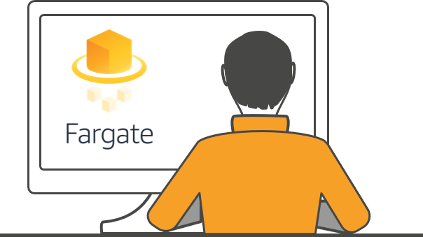
ENABLE FOCUS ON APPLICATIONS
Notes:
We took this feedback and have worked hard over the past year to build a technology that allows customers to focus entirely on their applications and work with their applications directly at the container or task-level.

Slide 38
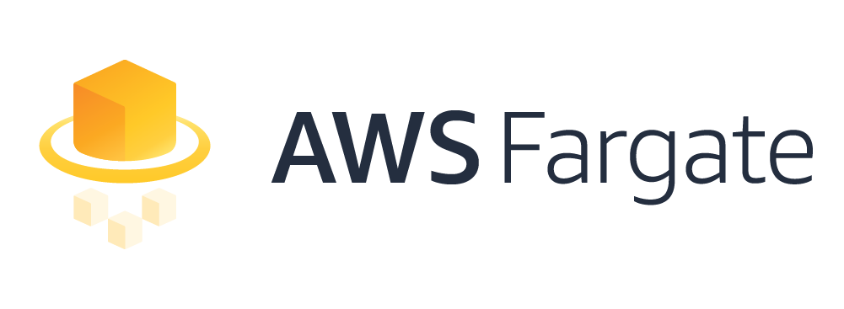

Simple, easy to use, powerful – and new consumption model
  No instances
  to manage
  Task
  native API
  Resource
  based pricing
Notes:
With Fargate:
You have no instances to manage: no more patching OS or runtimes
With the new Task Native API, you don’t need to worry about clusters (they are their as an organizational and security boundary), but you don’t need tow think about cluster utilization or Auto Scaling of compute resources within the cluster.
With the resource based pricing model you only pay for the resources you provision for each task.
We think Fargate fundamentally changes how you think about consumption; how you will run and deploy your applications with containers.

Slide 39
AWS ECS (Fully managed platform for your container)
Container
Hosts
Control Plane
Your container
No instances!
Amazon ECS API

Slide 40
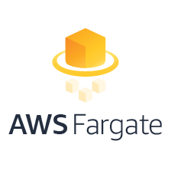
PRODUCTION WORKLOADS ON AWS
  AWS VPC networking mode
  Advanced task
  placement
  Deep integration
  with AWS platform
  ECS CLI
  Global footprint
  Powerful scheduling engines
  Auto scaling
  CloudWatch metrics
  Load balancers
…
{
}
Notes:
AWS Fargate is designed to be used with Amazon ECS, the core APIs, scheduling, and placement concepts remaing the same and you can continue to benefit from investments we’ve made there over the past three years with access to the same rich set of features and capabilities to run in production and at scale.

Slide 41
I want to use more open source in my environment

Slide 42
Notes:
A number of our customers run Kubernetes, either because they love the community and tools around k8s, and it is a very rich community and a broad set of tools, or because they want a toolchain that is just as portable as the containers running underneath. Most the k8s in the world runs on AWS. We wanted to make sure they had a great experience.

Slide 43
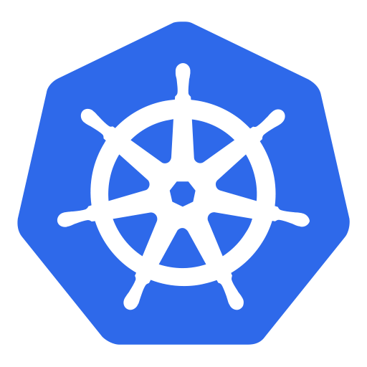

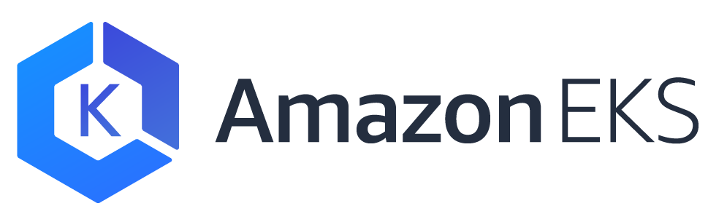
+
=
ELASTIC CONTAINER SERVICE FOR KUBERNETES
(EKS)
Notes:
Announcing the preview for Amazon EKS

Slide 44

Kubernetes (Open source container orchestration)
Container
Hosts
Control Plane
Your container
Worker Nodes
Masters
State Store

Slide 45
Amazon EKS (Fully managed control plane)
You
Amazon EKS
Your container
Worker Nodes
Masters
State Store

Slide 46
Fully managed (available in 2018)
You
AWS Fargate
Amazon EKS
Your container
Worker Nodes
Masters
State Store
Notes:
Even managing worker nodes can get annoying. It can be challenging to know just how many worker nodes you need to run your desired number of pods. In 2018 we will release a fully managed approach where the Kubernetes masters are run by AWS, and you also don’t have to manage worker nodes. Instead you will have the option to utilize AWS Fargate. Fargate is our on-demand container platform. Just like EC2 made it easy to get a VM on-demand without having to worry about physical servers in a datacenter, Fargate makes it easy to run a container on-demand without even worrying about VM’s.

Slide 47
virtual-kubelet (available today)
AWS Fargate
Worker
Control Plane
virtual-kubelet
Worker
https://aws.amazon.com/blogs/opensource/aws-fargate-virtual-kubelet/
Notes:
One step along the road to this fully managed Kubernetes is “virtual-kubelet”. This project is intended as a first look at an infinite scaling Kubernetes. The way it works is virtual-kubelet registers itself with the Kubernetes masters as if it is a worker node. But this special worker node has essentially infinite capacity to run pods because it isn’t running the pods inside a VM. Instead it is farming the pods out to AWS Fargate to run. This project is something that you can try out right now with your Kubernetes cluster. It isn’t necessarily production ready. There are still some caveats and room for improvement but it will serve as a first taste of what the future has in store.

Slide 48
In Summary
Docker allows you to easily run different code across different machines in a standardized, easily defined environment
Amazon Elastic Container Registry is a secure, private registry for Docker container images
Amazon Elastic Container Service allows you to schedule and run Docker containers on AWS
Amazon Elastic Container Service for Kubernetes is a managed service for running Kubernetes on AWS

Slide 49
We give you the power to choose:
AMAZON CONTAINER SERVICES
1
Choose your orchestration tool
ECS
EKS
2
Choose your launch type
EC2
Fargate
EC2
Fargate

Slide 50
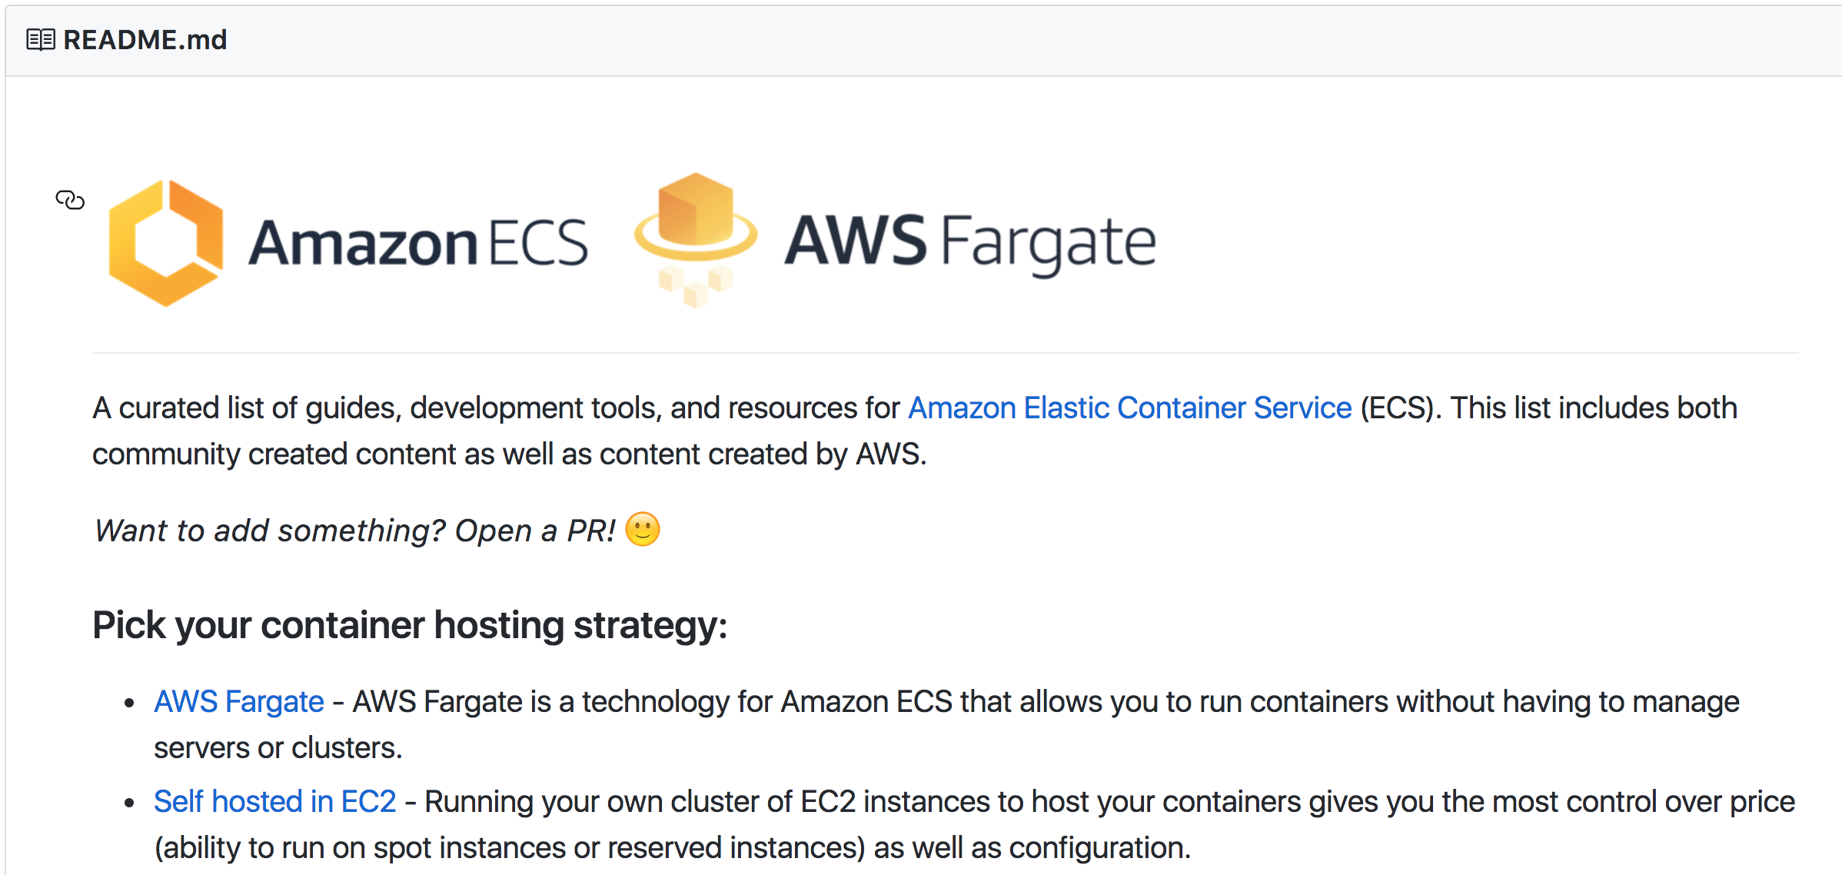
The awesome-ecs project:
https://github.com/nathanpeck/awesome-ecs

Slide 51
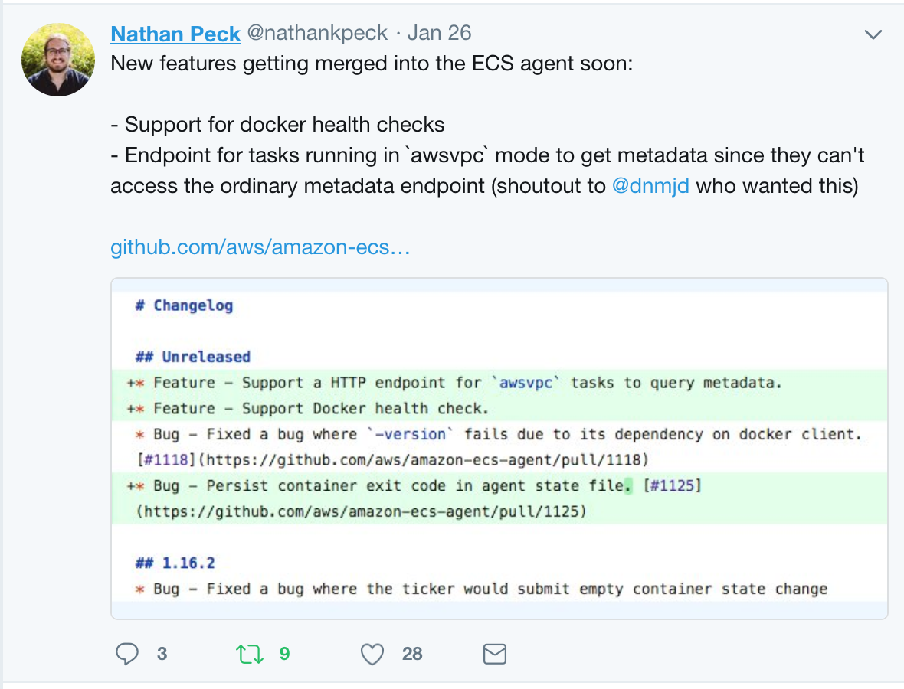
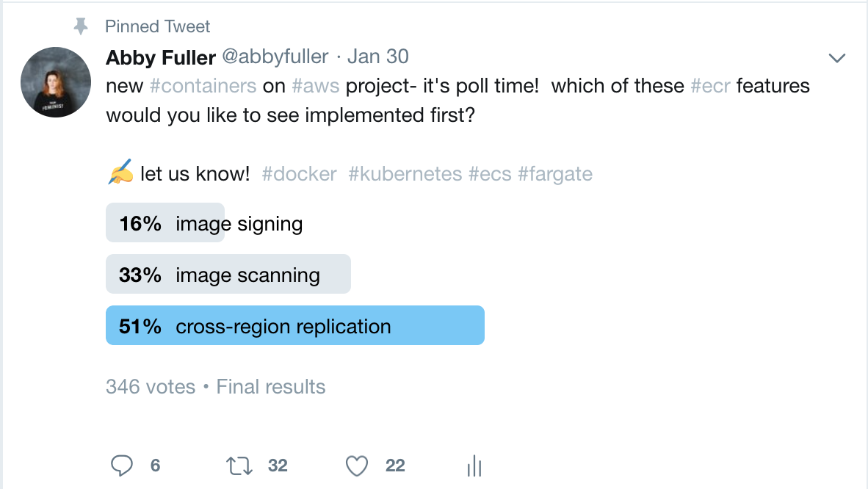
We want to hear from all of you!
More focus on supporting Tasks as compute primitive, more focus on removing undifferentiated heavy lifting.
Our roadmap is driven by feedback:

Slide 52
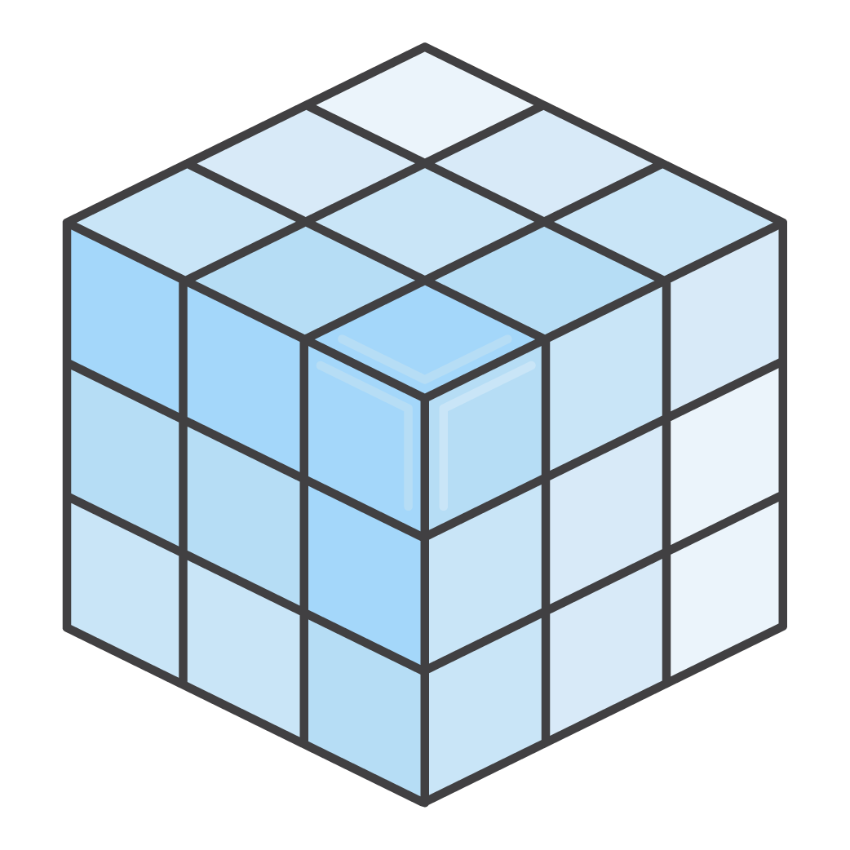
Thank you!

