Slide 1
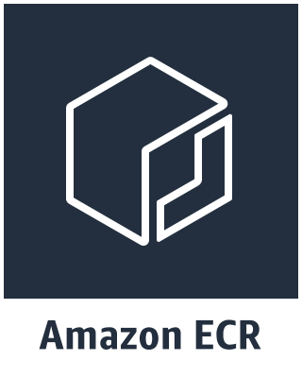
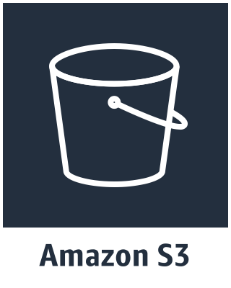
VPC
Public subnet
Private subnet
Internet gateway
NAT gateway
Instance
Instance

Slide 2
VPC
Public subnet
Private subnet
AWS PrivateLink VPC endpoints
AWS PrivateLink VPC endpoints
Instance
Instance
S3 Gateway VPC Endpoint
S3 Gateway VPC Endpoint

