Slide 2
Streamline the building and deployment of containerized applications
Nathan Peck
Senior Developer Advocate
Amazon Web Services

Slide 3
The levels of infrastructure deployment

Slide 4
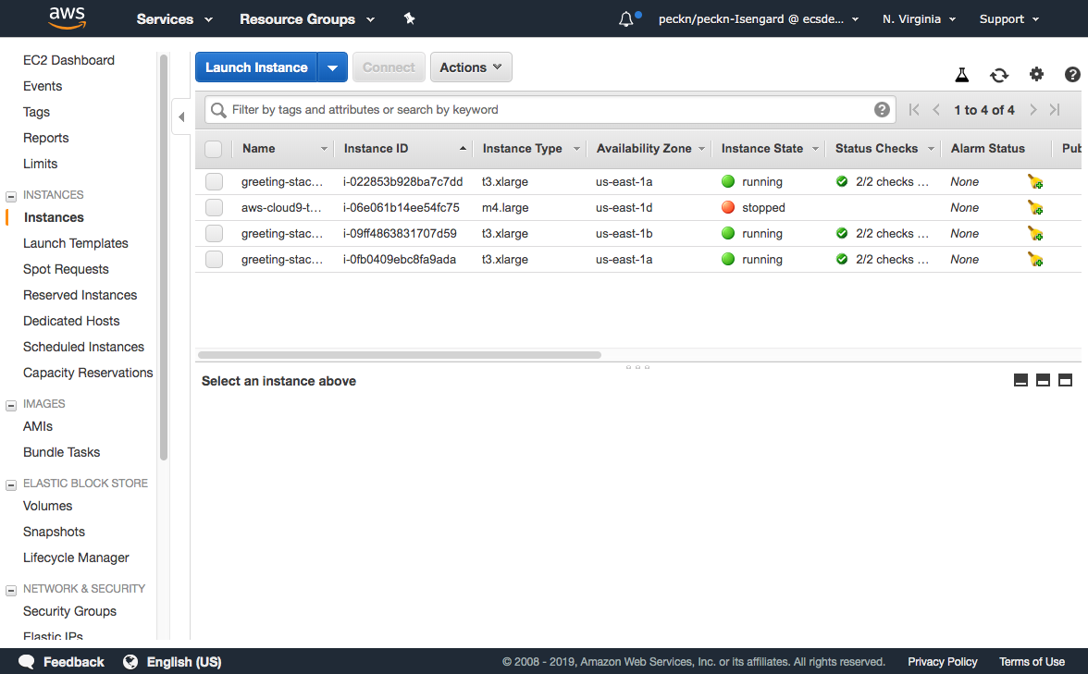
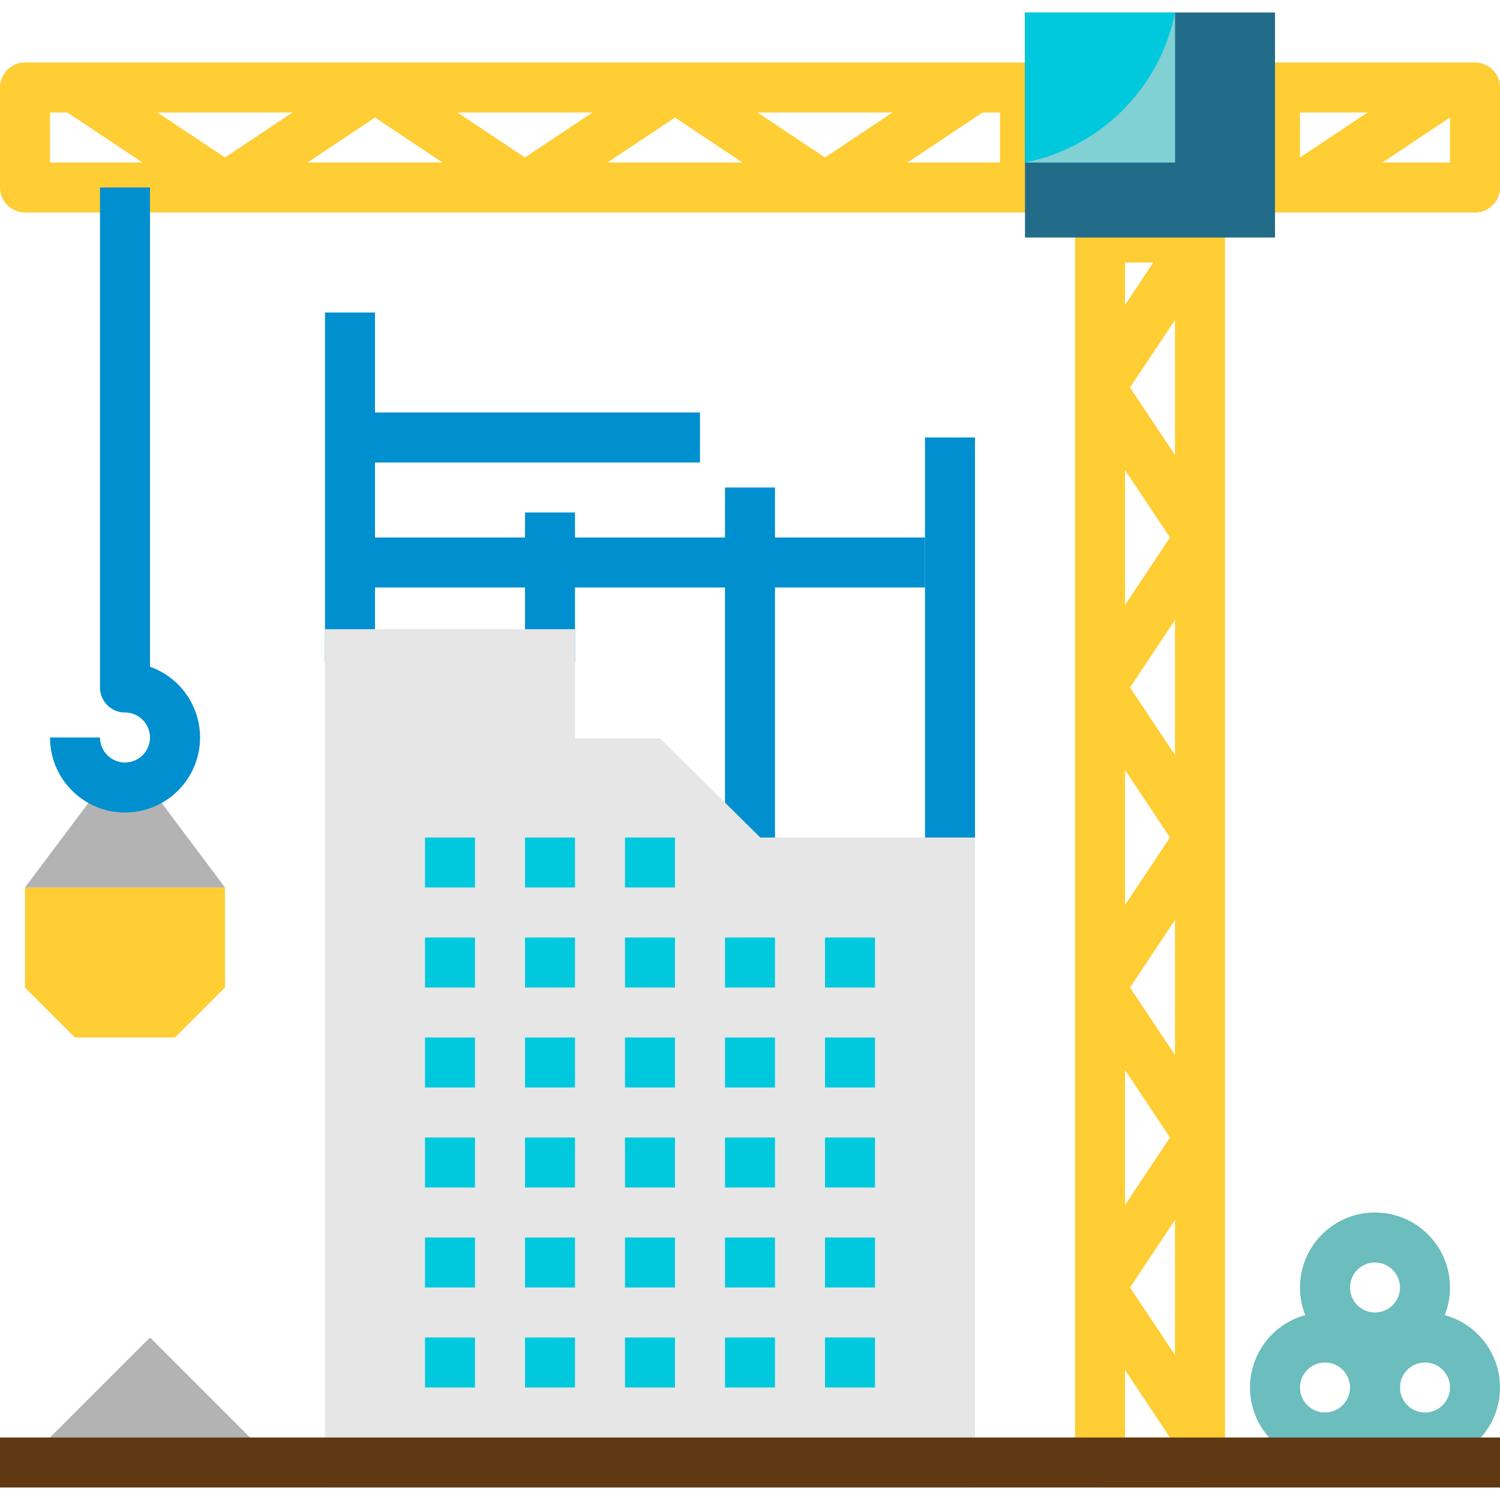
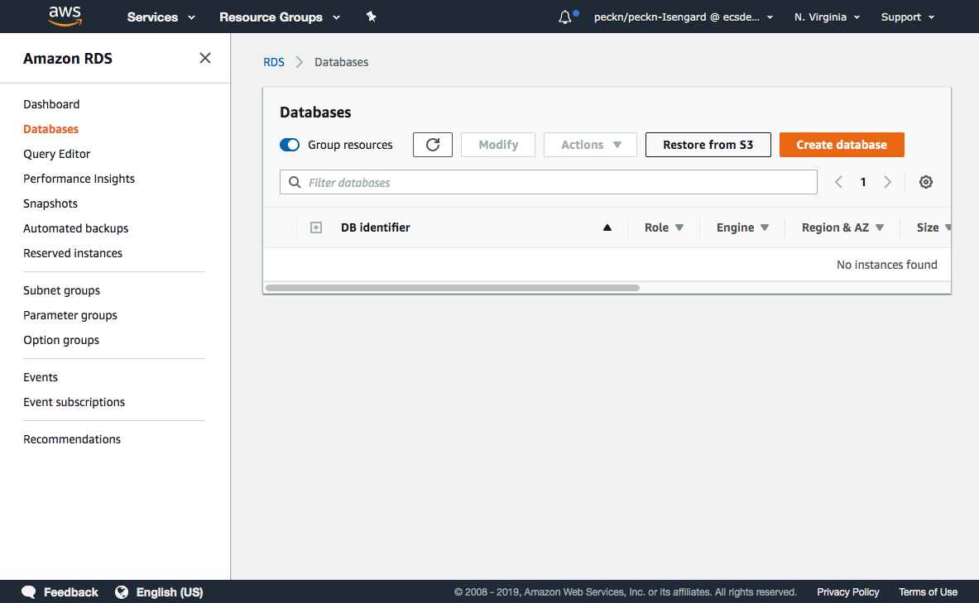
Level 0: Creating infrastructure by hand
Your organization’s
infrastructure
Notes:
EDIT: replaced hyphen with colon

Slide 5
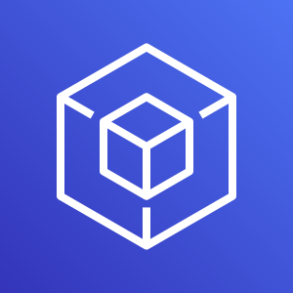
Level 1: Imperative infrastructure as code
deploy.sh
AWS SDK
Your organization’s
infrastructure
Notes:
EDIT: replaced hyphen with colon

Slide 6
Level 2: Declarative infrastructure as code
AWS CloudFormation
AWS SDK
infrastructure.yml
Your organization’s
infrastructure
HashiCorp
Terraform
Notes:
EDIT: replaced hyphen with colon

Slide 7
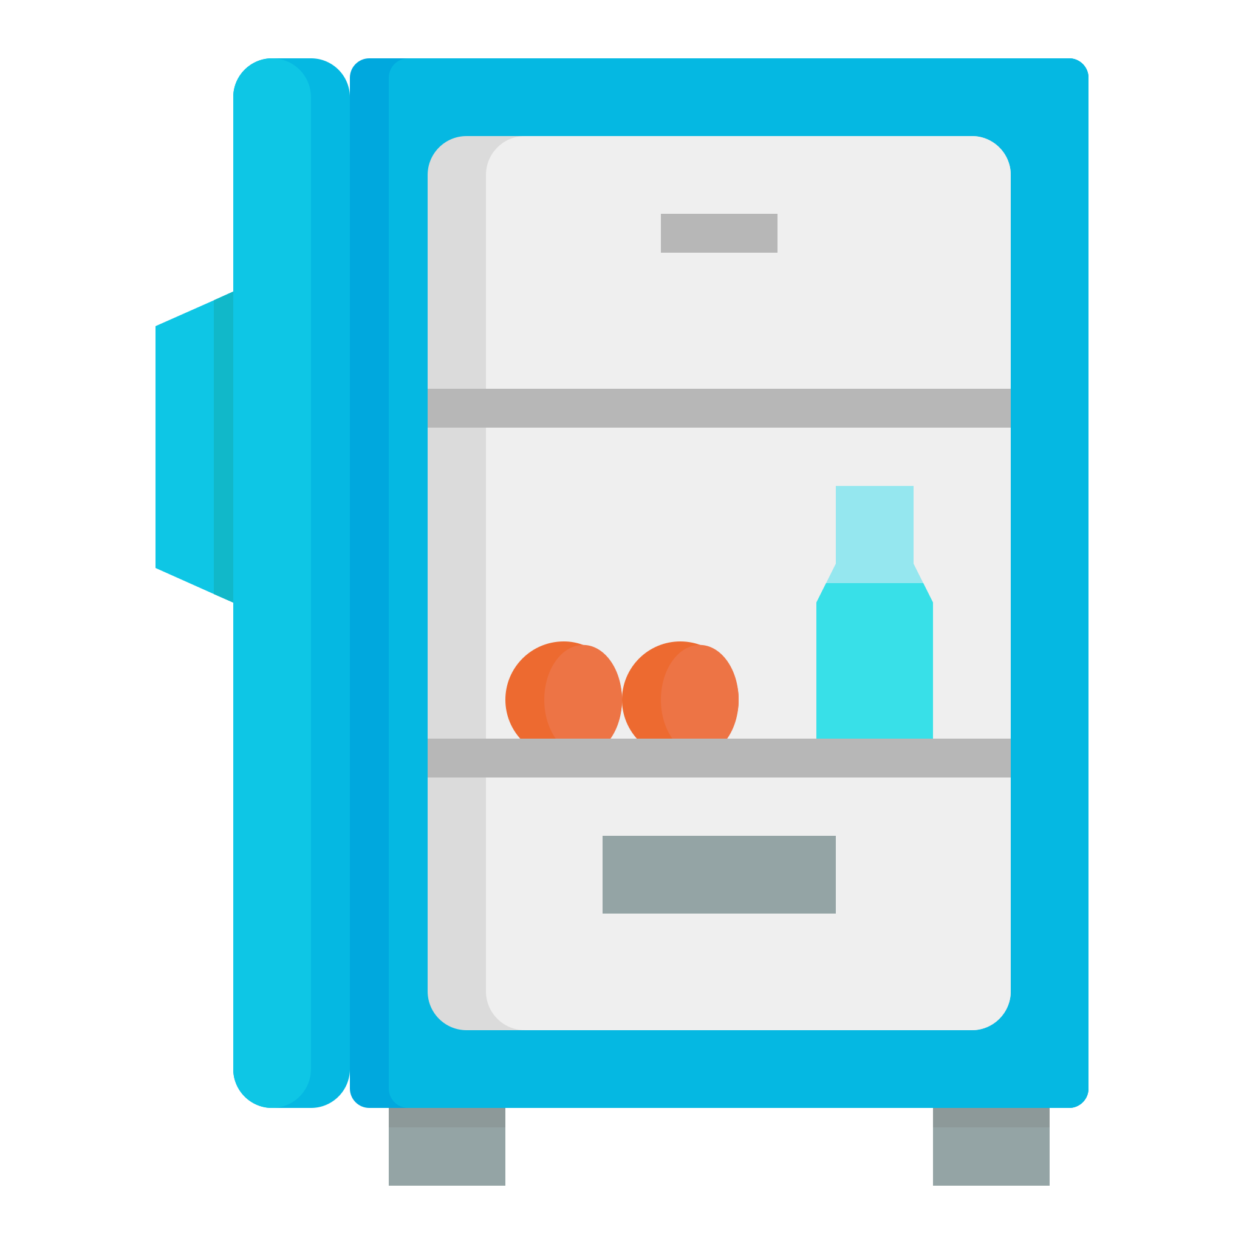
Infrastructure as code is like a shopping list
“I need a dozen eggs, a carton of milk, a carrot, and a loaf of bread”
You
You get a grocery delivery back
Them
Shop for any missing items
What is already in the refrigerator?
Notes:
EDIT: deleted "To have" from the shopping list quote. added oxford comma

Slide 8
Level 2: Declarative infrastructure as code
Resources:
BucketOne:
Type: AWS::S3::Bucket
Properties:
AccessControl: PublicRead
Amazon Simple Storage Service (S3)
AWS CloudFormation
AWS SDK
BucketOne
Notes:
EDIT: replaced hyphen with colon

Slide 9
Level 2: Declarative infrastructure as code
Resources:
BucketOne:
Type: AWS::S3::Bucket
Properties:
AccessControl: PublicRead
BucketTwo:
Type: AWS::S3::Bucket
Properties:
AccessControl: Private
Amazon Simple Storage Service (S3)
AWS CloudFormation
AWS SDK
BucketOne
BucketTwo
Notes:
EDIT: replaced hyphen with colon

Slide 10
Level 3: Infrastructure as code abstraction
AWS Cloud Development Kit
AWS CloudFormation
AWS SDK
Your organization’s
infrastructure
AWS Copilot
Notes:
EDIT: replaced hyphen with colon

Slide 11
Abstractions are like ordering at a restaurant
You
“I’d like a tasty steak dinner please”
Them
Restaurant decides what ingredients are needed
Restaurant goes “shopping” for you
Restaurant cooks the meal for you

Slide 12
AWS Cloud Development Kit (CDK)
Notes:
EDIT: added CDK acronym here in parentheses, as first mention, removed from slide 15

Slide 13
Example: Virtual Private Cloud (VPC)
Public Subnet in Availability Zone
Public Subnet in Availability Zone 2
Private Subnet in Availability Zone
Private Subnet in Availability Zone 2
VPC
Internet gateway
NAT gateway
NAT gateway
Notes:
COMMENT: is there content missing from the two right side columns?

Slide 14
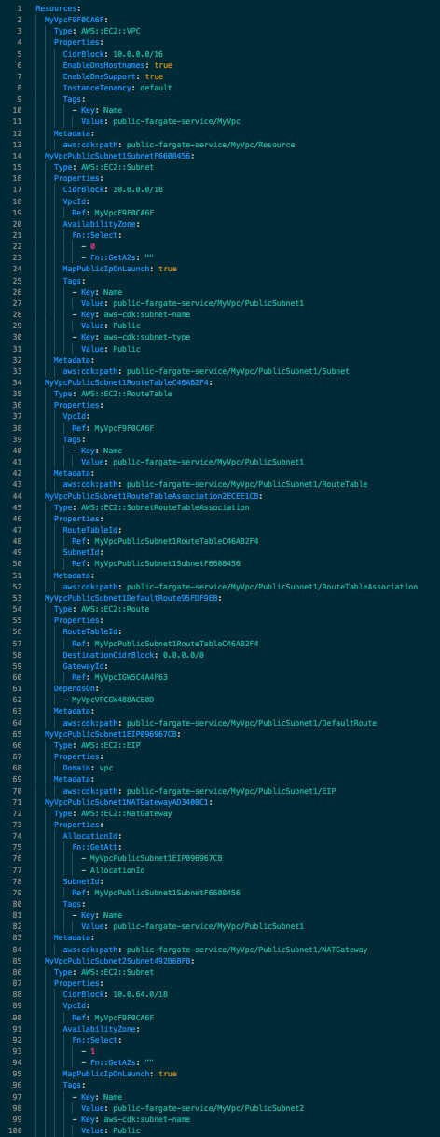
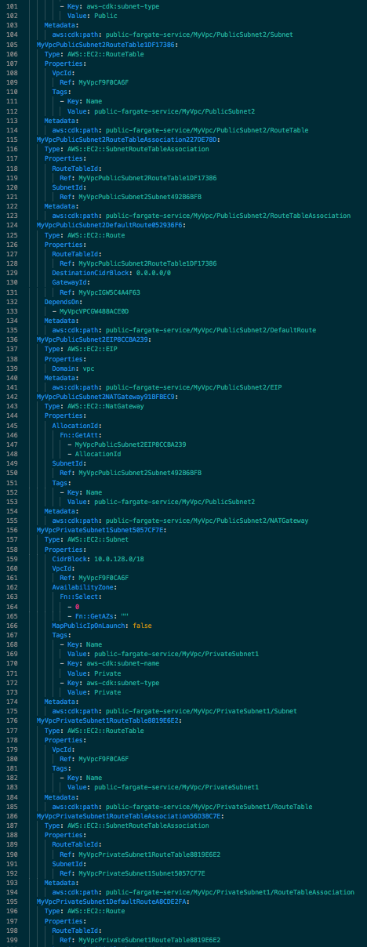
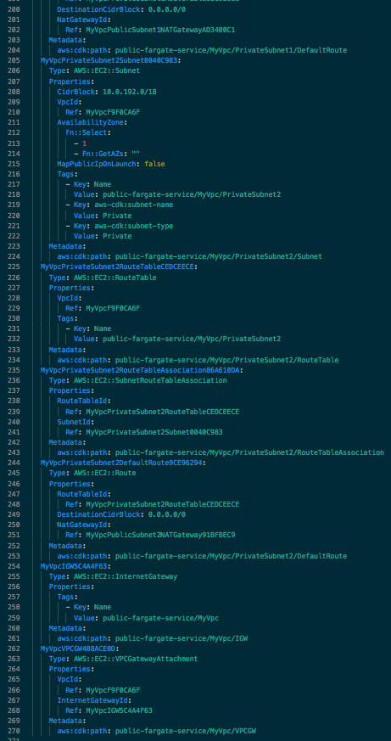
CloudFormation for that VPC?
270 lines of CloudFormation YAML!
Each resource is explicitly described in detail—every property and every route in the route table.
Notes:
EDIT: replaced colon with em hyphen
replaced comma with "and"
COMMENT: is ? Intentional

Slide 15
AWS Cloud Development Kit
// Give me a VPC network for all my resources
const vpc = new ec2.Vpc(stack, 'MyVpc', { maxAzs: 2 });
From 270 lines down to one line, AWS CDK provides sensible default resources based on your higher level intent.
Notes:
EDITS: replaced period with comma, added period at the end

Slide 16
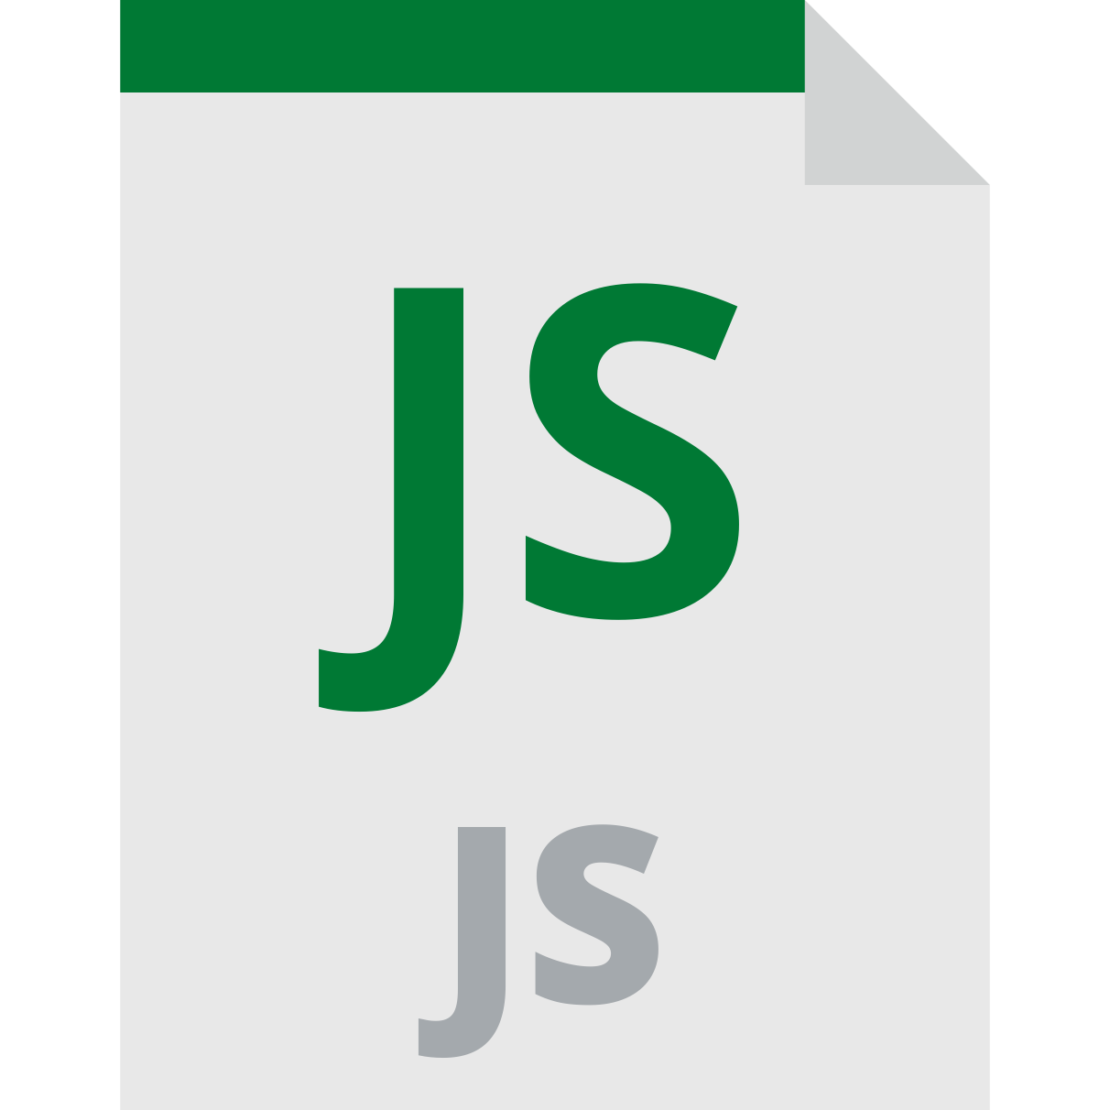
@aws-cdk/aws-ecs: Ship a container image
import ecs = require('@aws-cdk/aws-ecs’);
const image = ecs.ContainerImage.fromAsset("apps/myapp")
Dockerfile
my-code.js
Amazon Elastic Container Registry
docker build
Container image for your application
myapp registry
apps/myapp

Slide 17
@aws-cdk-containers/ecs-service-extensions
const environment = new Environment(stack, 'production');
const serviceDescription = new ServiceDescription();
serviceDescription.add(new Container({
cpu: 256,
memoryMiB: 512,
trafficPort: 80,
image: ecs.ContainerImage.fromRegistry('myapp/demo'),
}));
new Service(stack, 'my-service', {
environment,
serviceDescription,
});

Slide 18
Composable, extendable interface for service construction
service.add(new Container({
cpu: 256,
memoryMiB: 512,
trafficPort: 80,
image: ecs.ContainerImage.fromRegistry('myapp/demo'),
}));
service.add(new AppMeshExtension({ mesh }));
service.add(new FireLensExtension());
service.add(new XRayExtension());
service.add(new CloudwatchAgentExtension());
service.add(new HttpLoadBalancerExtension());
You can build your own extensions too!
Notes:
EDIT: Left aligned bottom line to rest of slide content

Slide 19
AWS Copilot

Slide 20
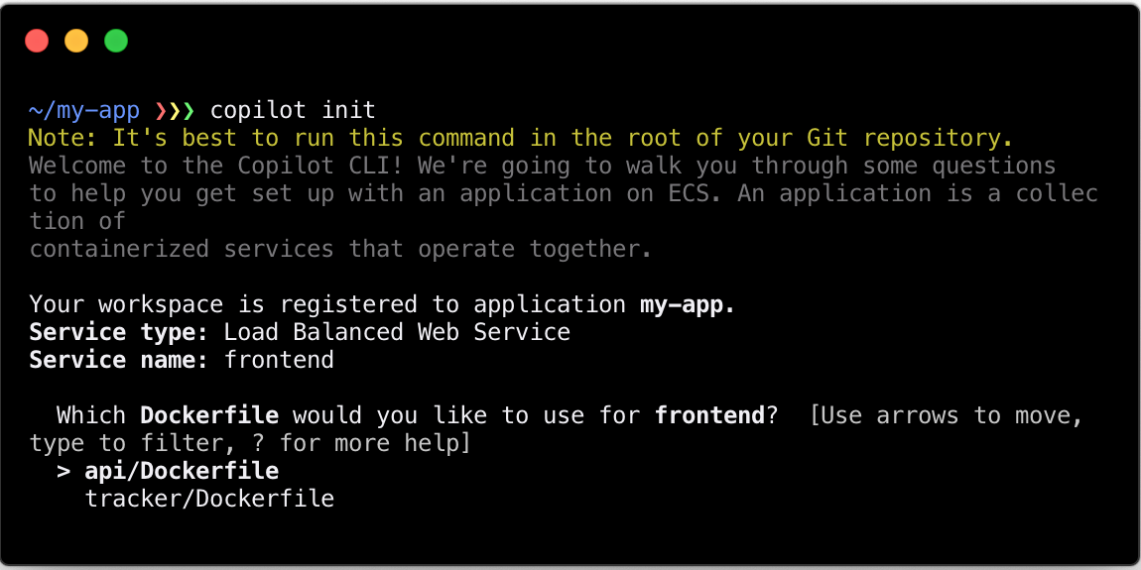
AWS Copilot is a command line tool

Slide 21
AWS Copilot core operations
Build and deploy your application:
AWS Copilot asks questions about what type of architecture you want, then it does the rest!
Monitor and observe:
AWS Copilot helps you see your service’s health, tail your logs, or get a command line shell inside of a running container
Automate:
AWS Copilot sets up an automated delivery pipeline that can build and deploy your containerized application whenever you push to your git repository.
Notes:
EDIT: added 3 colons

Slide 22
Demo time!
Notes:
EDIT: lowercase time

